Slide 1
Solar wind discontinuities beyond 1AU
Zijin Zhang, Anton Artemyev, Vassilis Angelopoulos, Shi Chen
Thank Xiaofei Shi, Sergey Kamaletdinov, Zesen Huang for discussion

Slide 2
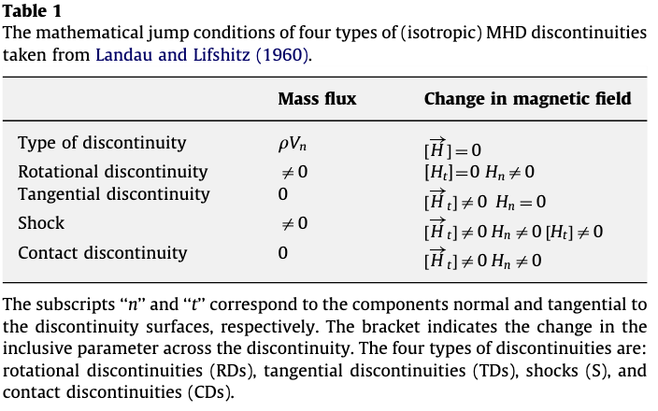
Solar wind discontinuities
Discontinuous changes in plasmas parameters and magnetic ﬁelds
Colburn et al., 1966

Slide 3
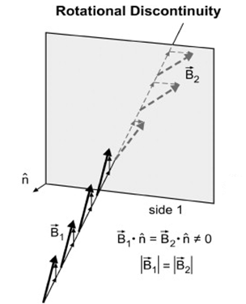
Solar wind discontinuities
Two examples of discontinuities observed by Ulysses at the radial distance r~2 AU and by Voyager 1 at r~100 AU.
Panels (a, b): Ulysses magnetic field measurements in the local coordinate system and hodograph of magnetic field B_{m}(B_{l}) (figures are adopted from Tsurutani et al., 1997).
Panel (c): a hodograph of magnetic field B_{m}(B_{l}) from Voyager 1 measurements (figure is adopted from Tsurutani, 2011).
Notes:
What? Solar wind discontinuities refer to abrupt changes in the properties of the solar wind, such as velocity, density, temperature, and magnetic field. These discontinuities can occur at various scales and are important for understanding solar wind dynamics, as well as its interactions with the Earth's magnetosphere and other solar system bodies.
How common?

Slide 4
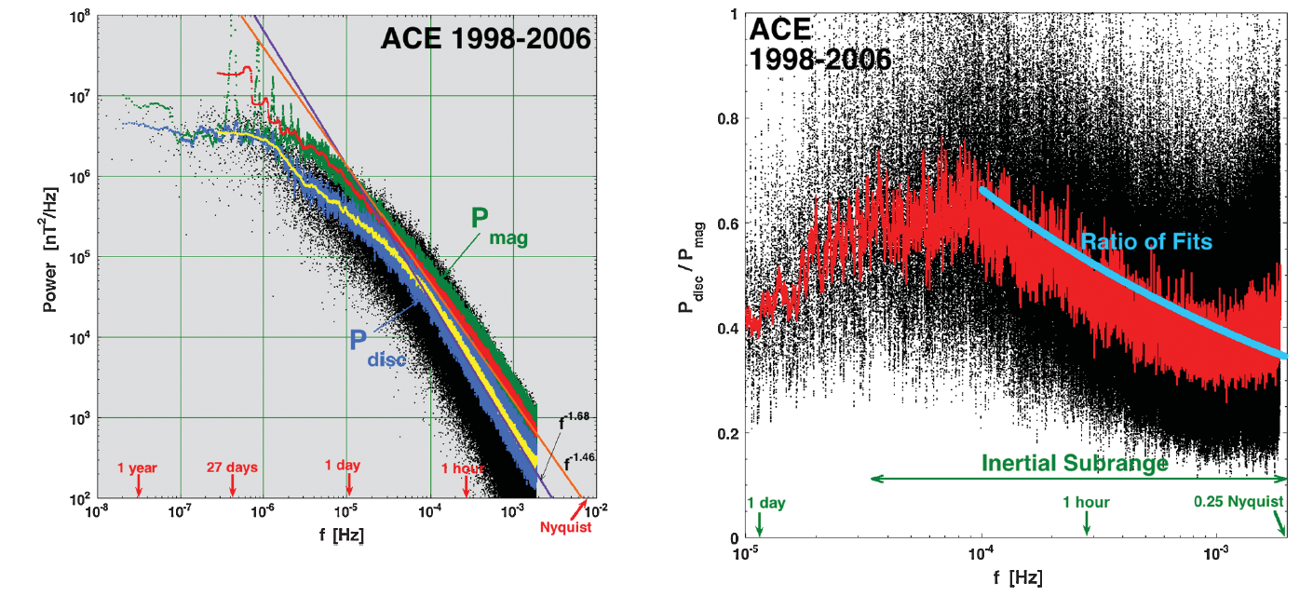
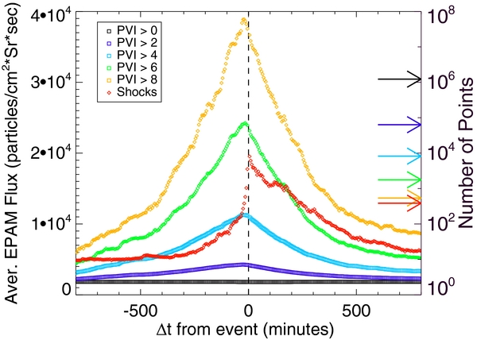
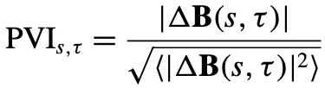
Importance of solar wind discontinuities
Solar Wind Turbulences
Energetic Particles
The discontinuity spectrum contains about half of the power of the full solar-wind magnetic field over this ‘‘inertial subrange.’’
Stronger association of suprathermal particles (0.047–4.75 MeV) with magnetic discontinuities than shocks.
Borovsky 2010
Partial Variance of Increments
Tessein et al., 2013
Notes:
We are interested in solar wind discontinuities because they are an import element of solar wind turbulences….
There is one result from Borovsky paper
The strong discontinuities produce a power-law spectrum in the “inertial subrange” with a spectral index near the Kolmogorov −5/3 index. The discontinuity spectrum contains about half of the power of the full solar-wind magnetic field over this “inertial subrange.”
From another point of view, SWD are a type of very kinetic structure. Which means that they can interact with the energetic part of the solar wind ions.
Various mechanisms have been proposed for the acceleration of the solar wind suprathermal particle populations, including shock acceleration, stochastic acceleration, and acceleration due to random reconnection sites and compressions
A stronger association of energetic particle flux in the 0.047–4.75 MeV range is found with intense magnetic discontinuities than is found with shocks.
Partial Variance of Increments
PVI method is sensitive to directional changes, magnitude changes, and any form of sharp gradient in the vector magnetic field B. The PVI quantity is not biased toward a particular type of discontinuity (directional, tangential, and rotational discontinuities and shocks) or other structures.
Various mechanisms have been proposed to explain observed suprathermal particle populations in the solar wind, including direct acceleration at flares, stochastic acceleration, shock acceleration, and acceleration by random compression or reconnection sites. Using magnetic field and suprathermal particle data from the Advanced Composition Explorer (ACE), we identify coherent structures and interplanetary shocks, and analyze the temporal association of energetic particle fluxes with these coherent structures. Coherent structures having a range of intensities are identified using the magnetic Partial Variance of Increments statistic, essentially a normalized vector increment. A stronger association of energetic particle flux in the 0.047–4.75 MeV range is found with intense magnetic discontinuities than is found with shocks. Nevertheless, the average profile of suprathermals near shocks is quite consistent with standard models of diffusive shock acceleration, while a significant amount of the energetic particles measured and strong discontinuities are found by ACE within six hours of a shock. This evidence supports the view that multiple mechanisms contribute to the acceleration and transport of interplanetary suprathermal particles.

Slide 5
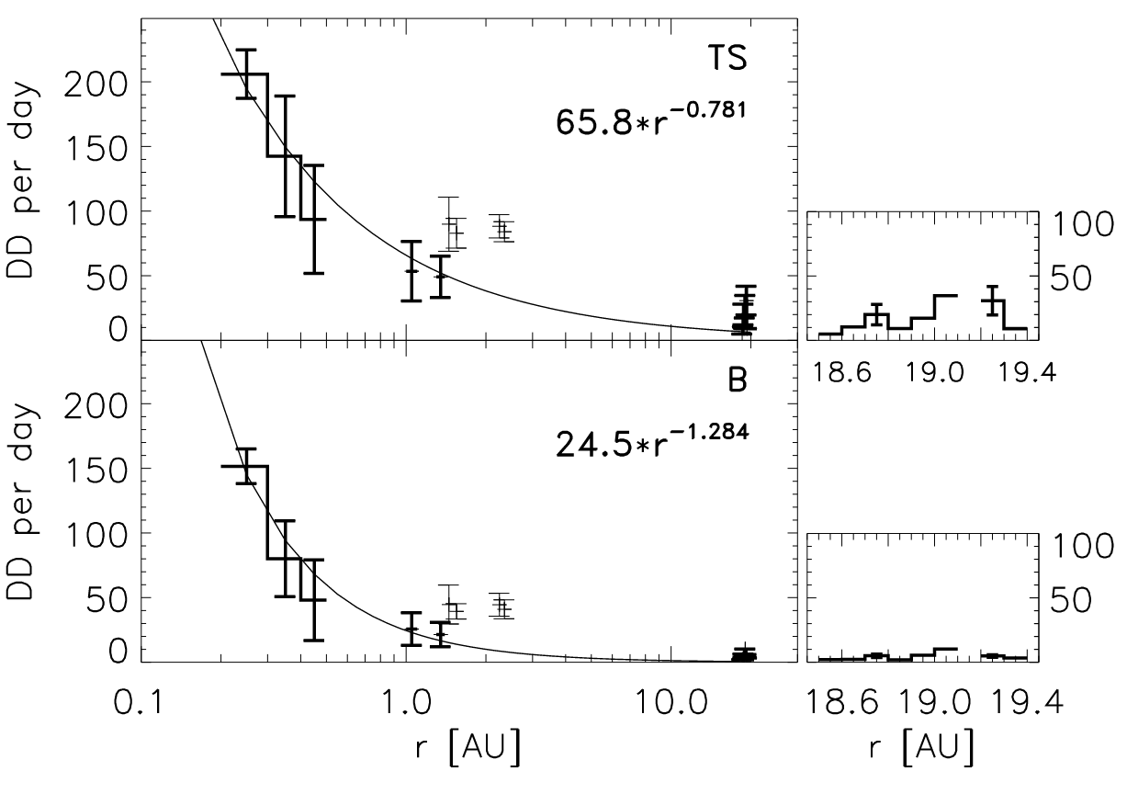
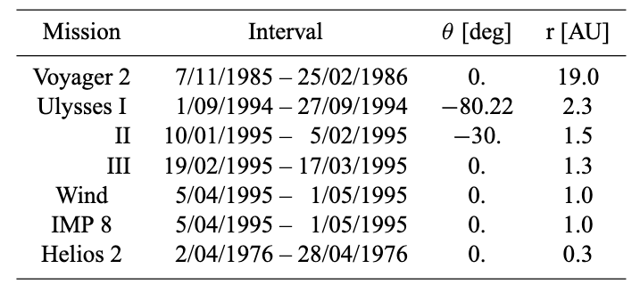
Radial dependencies of discontinuities
Typical rate of occurrence is about 50 per day at 1AU
Söding et al., 2001

Slide 6
Motivation
Studying the radial distribution of occurrence rate, as well as the properties of solar wind discontinuities may help answer the following questions:
How does the discontinuities change with the radial distance from the Sun?
How is solar wind discontinuities formed? What is the physical mechanisms?
Generated at or near the sun?
Locally generated in the interplanetary space by turbulence?
Joint observations of JUNO & ARTEMIS & Other missions really provides a unique opportunity!!!

Slide 7
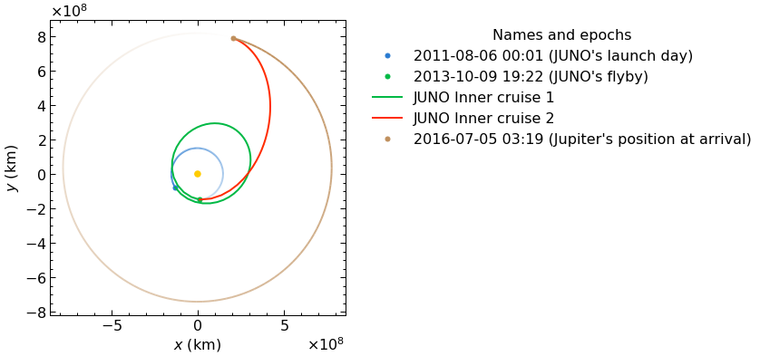
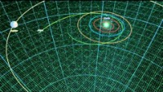
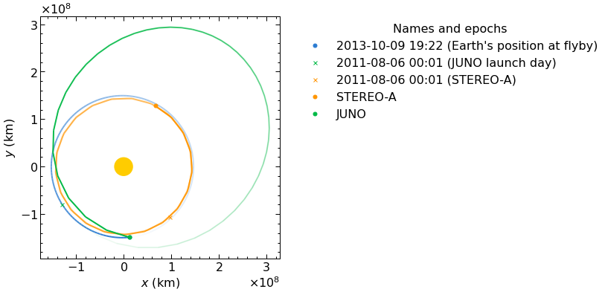

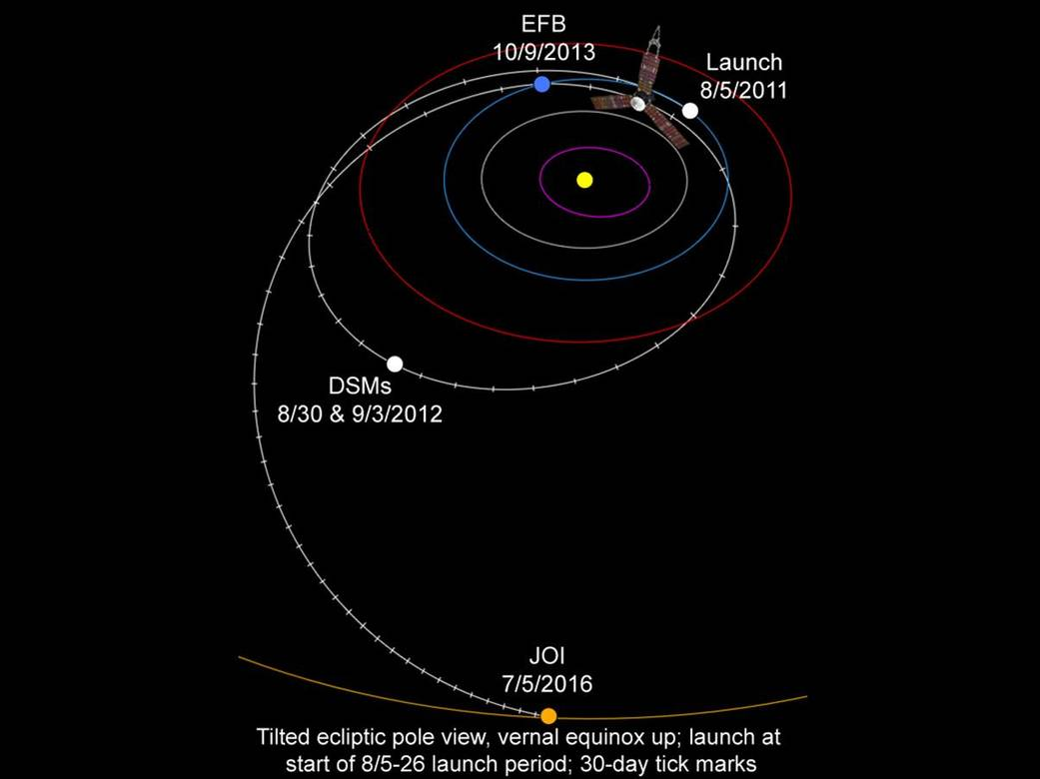
Juno Orbit
- Five-year cruise to Jupiter from 2011 to 2016
- One earth flyby in 2013
- Nearly the same Heliographic latitude as Earth

Slide 8
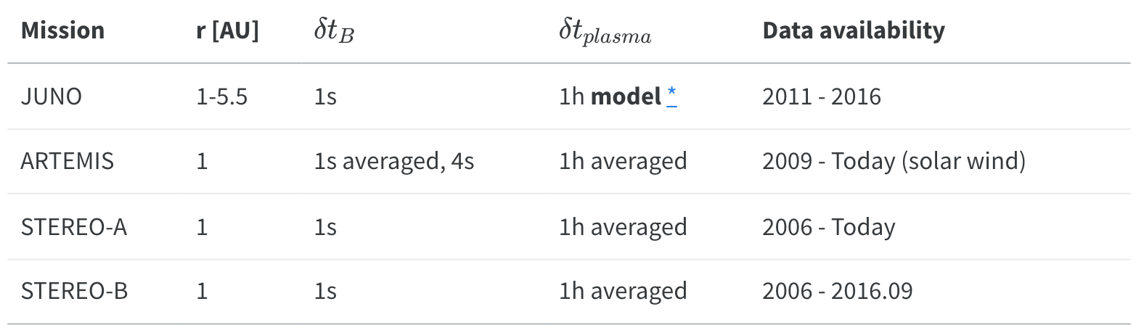
Datasets Overview
To eliminate the effect of the solar wind structure, we use data from other missions (mainly at 1AU) to provide a way of normalization.

Slide 9
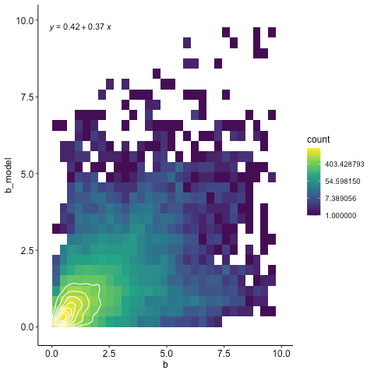
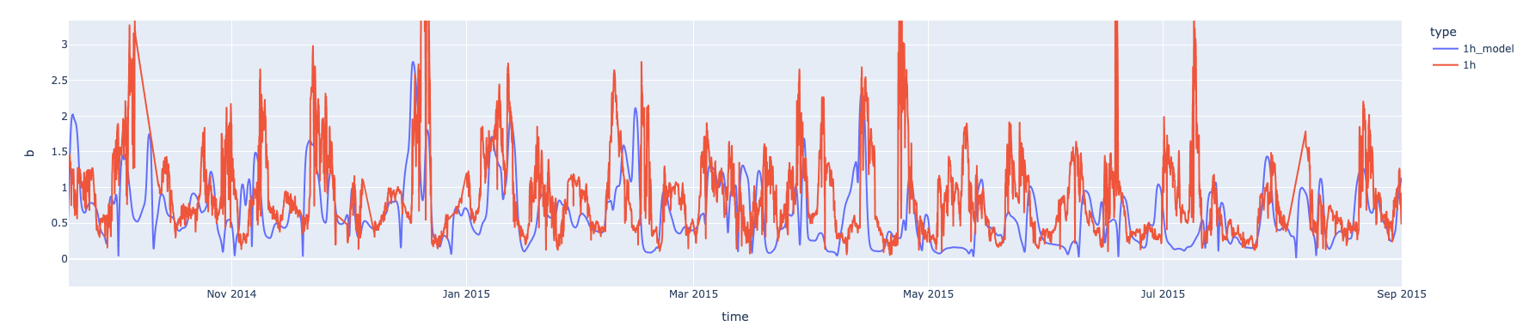
Solar Wind Model (MSWIM2D)
Representing the solar wind in the ecliptic plane from 1 to 75 au
2D MHD model, using the BATSRUS MHD solver
Inner boundary filled by time-shifting data from multiple spacecraft
1h model
1h JUNO
B

Slide 10
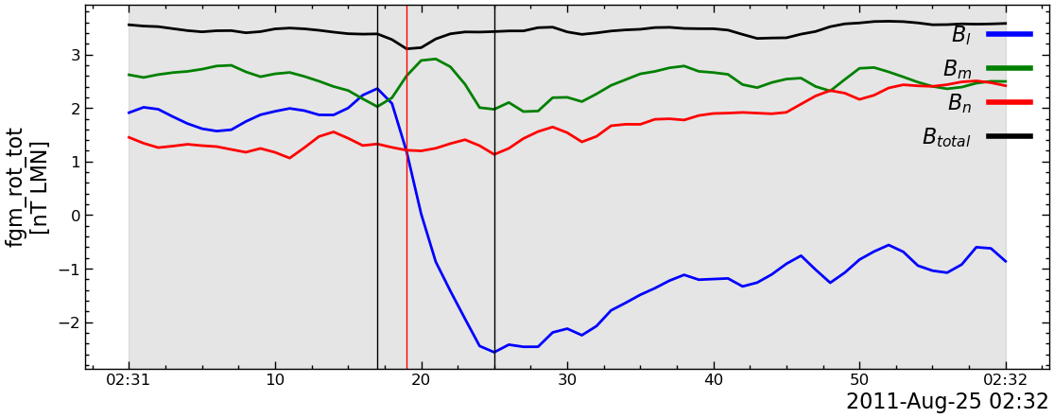
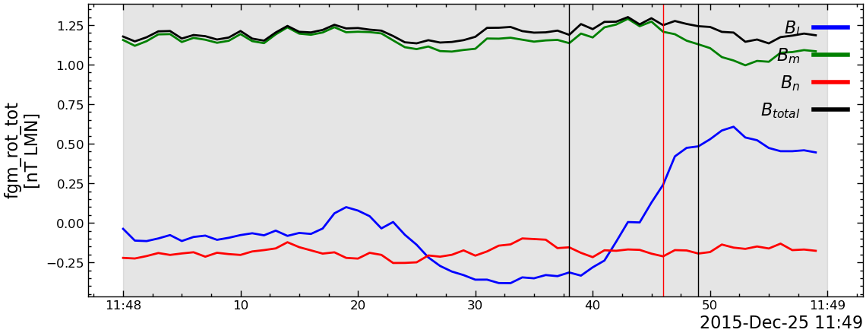
Examples of solar wind discontinuities (SWD)
ARTEMIS-B
JUNO

Slide 11
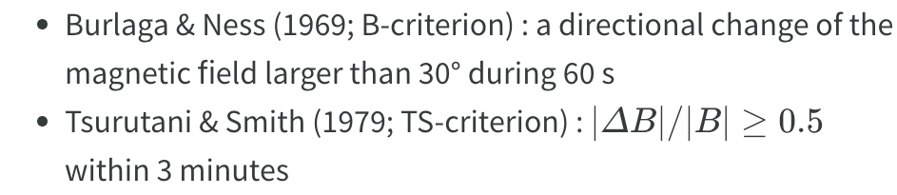
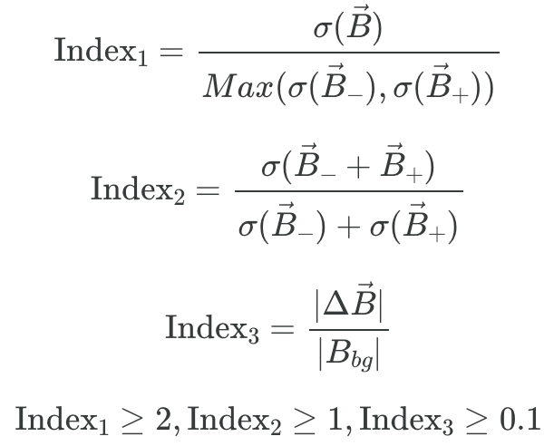
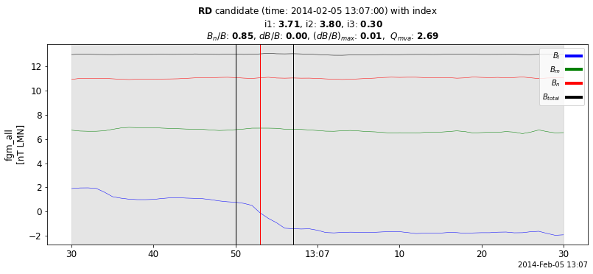
Methods (Identification/Detection)
Liu, 2022
Notes:
The ﬁrst two conditions guarantee that the ﬁeld changes of the IDs identiﬁed are large enough to be distinguished from the stochastic ﬂuctuations on magnetic ﬁelds, while the third is a supplementary condition to reduce the uncertainty of recognition.

Slide 12
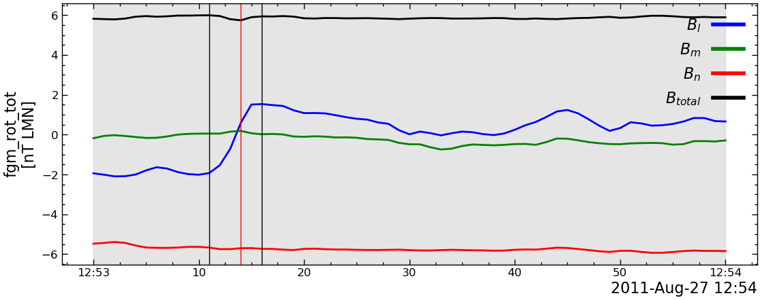
ID parameters (MVA features extraction)
Orientation
Intensity
Duration

Slide 13
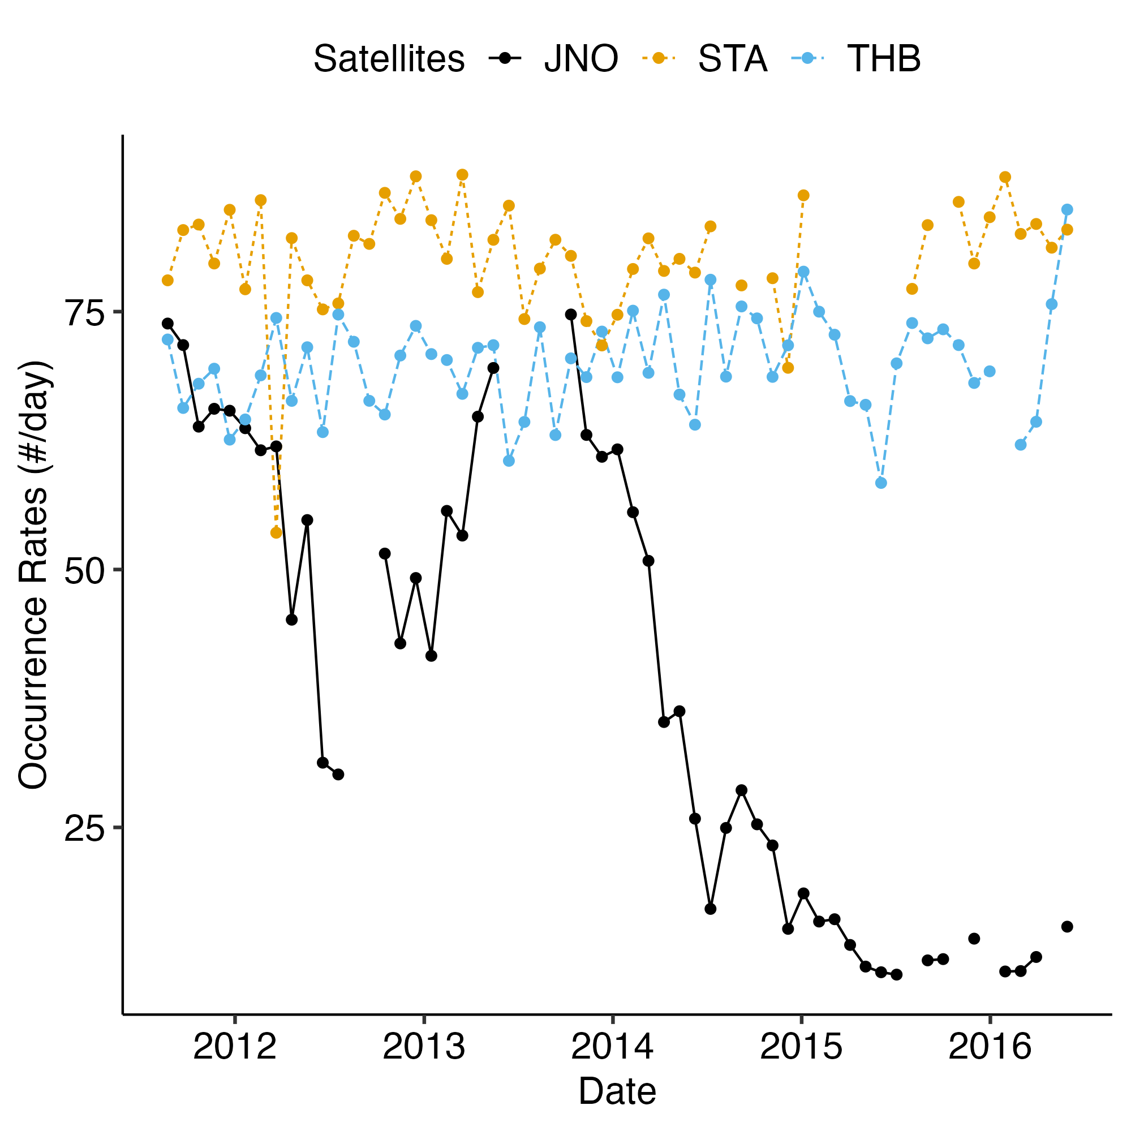
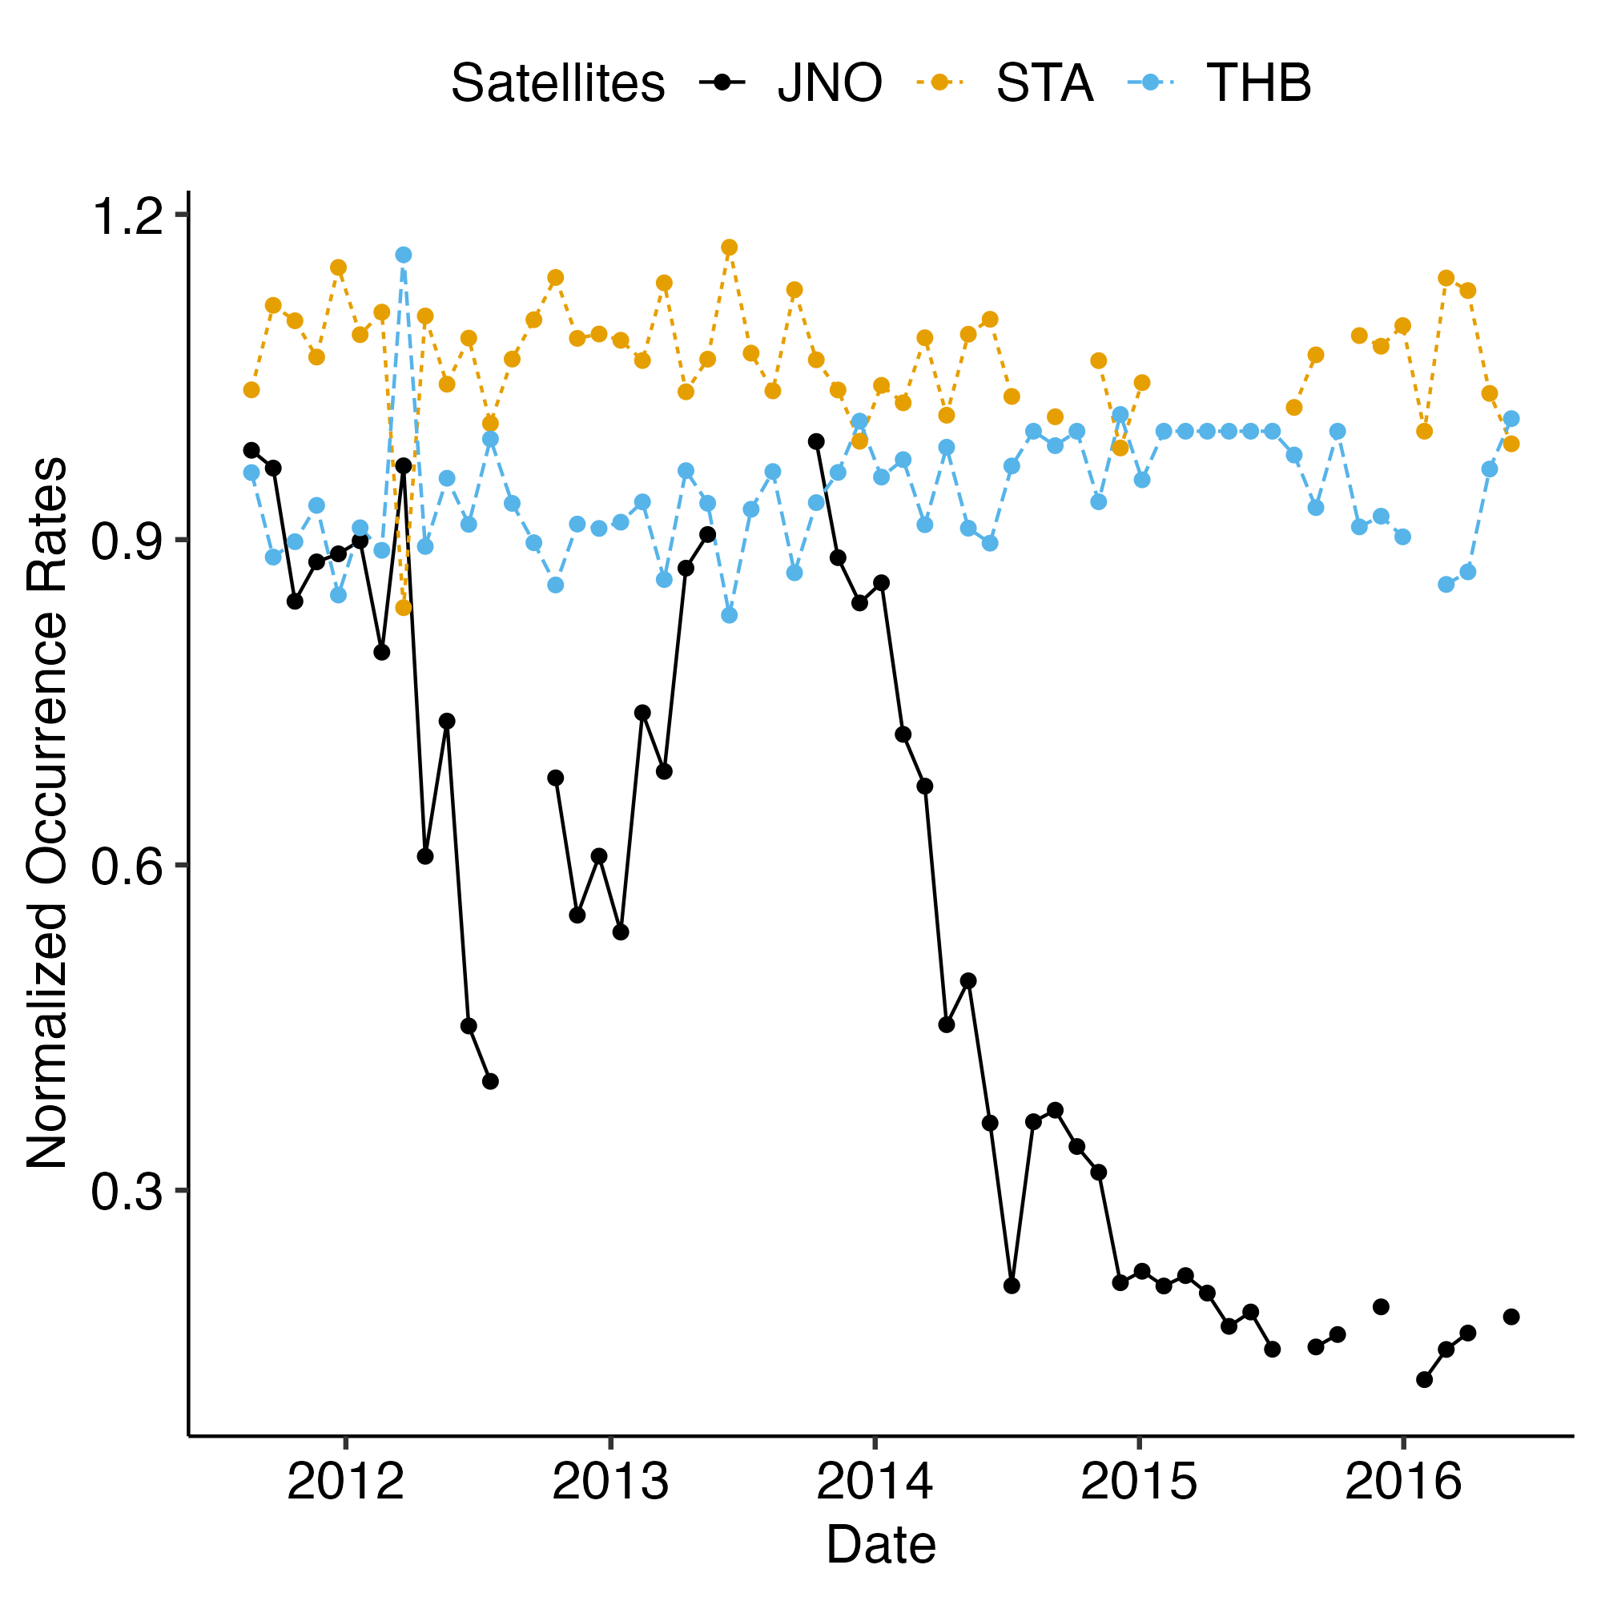
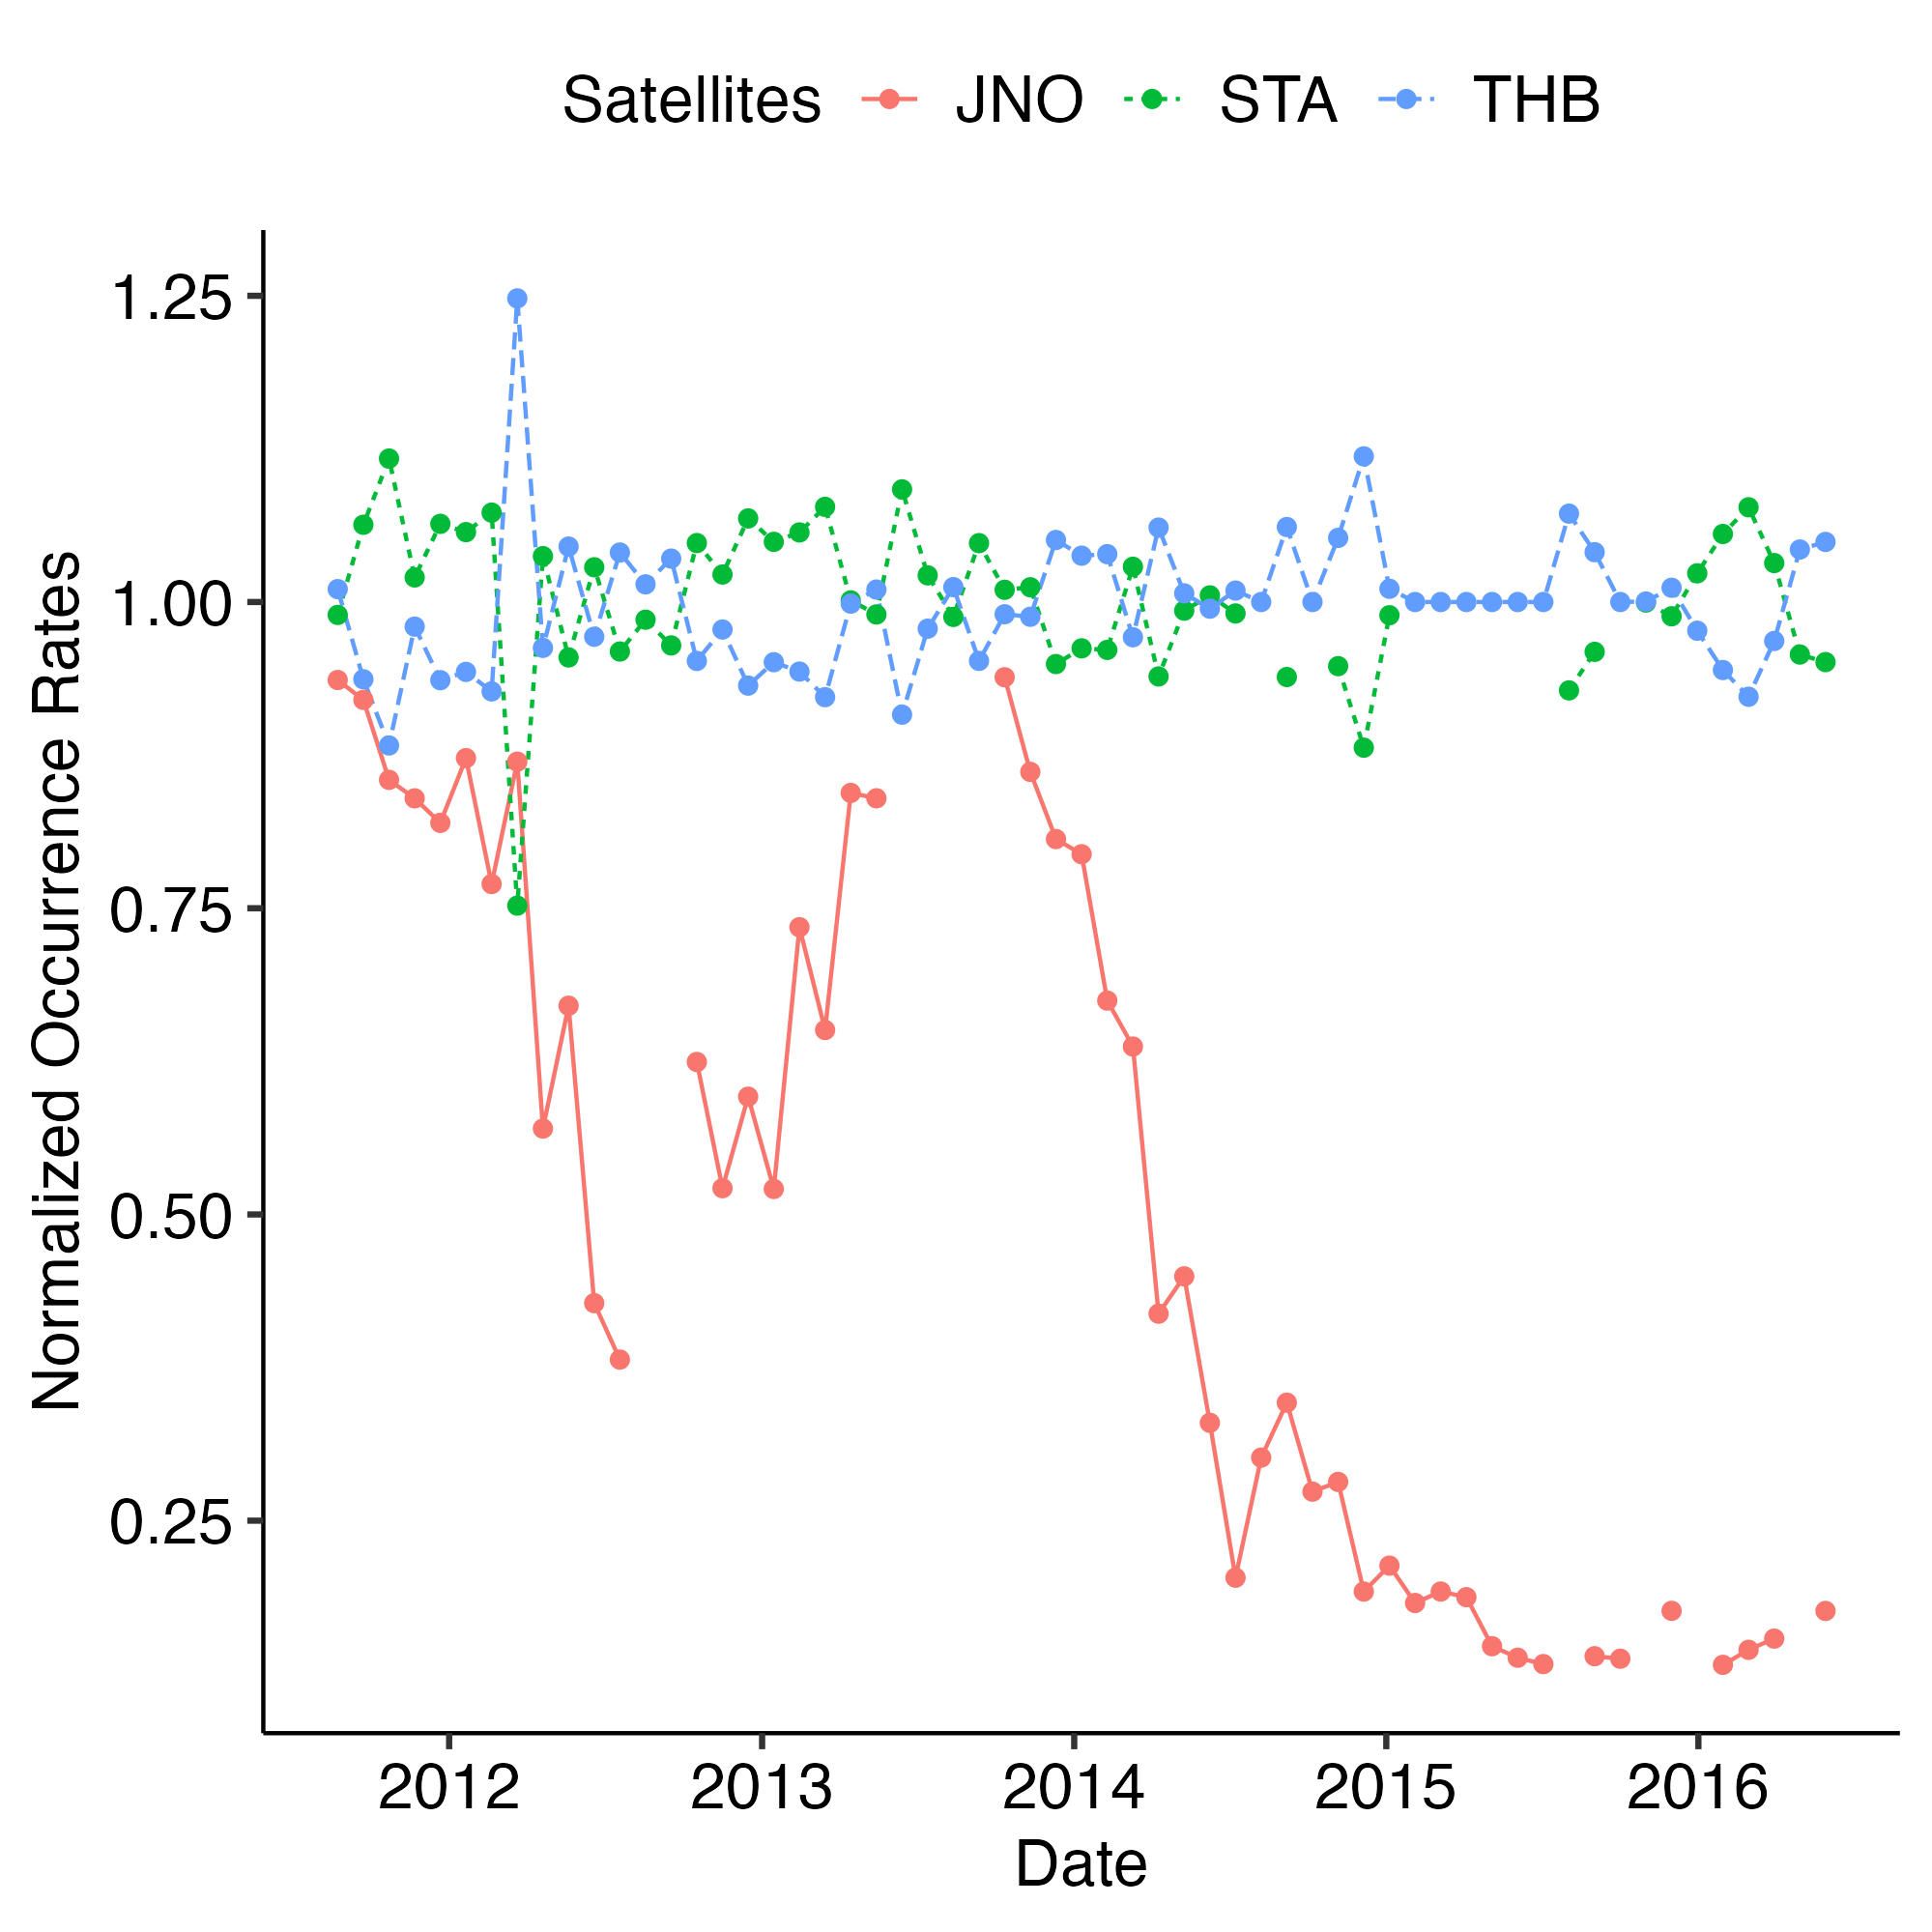
Occurrence rates

Slide 14
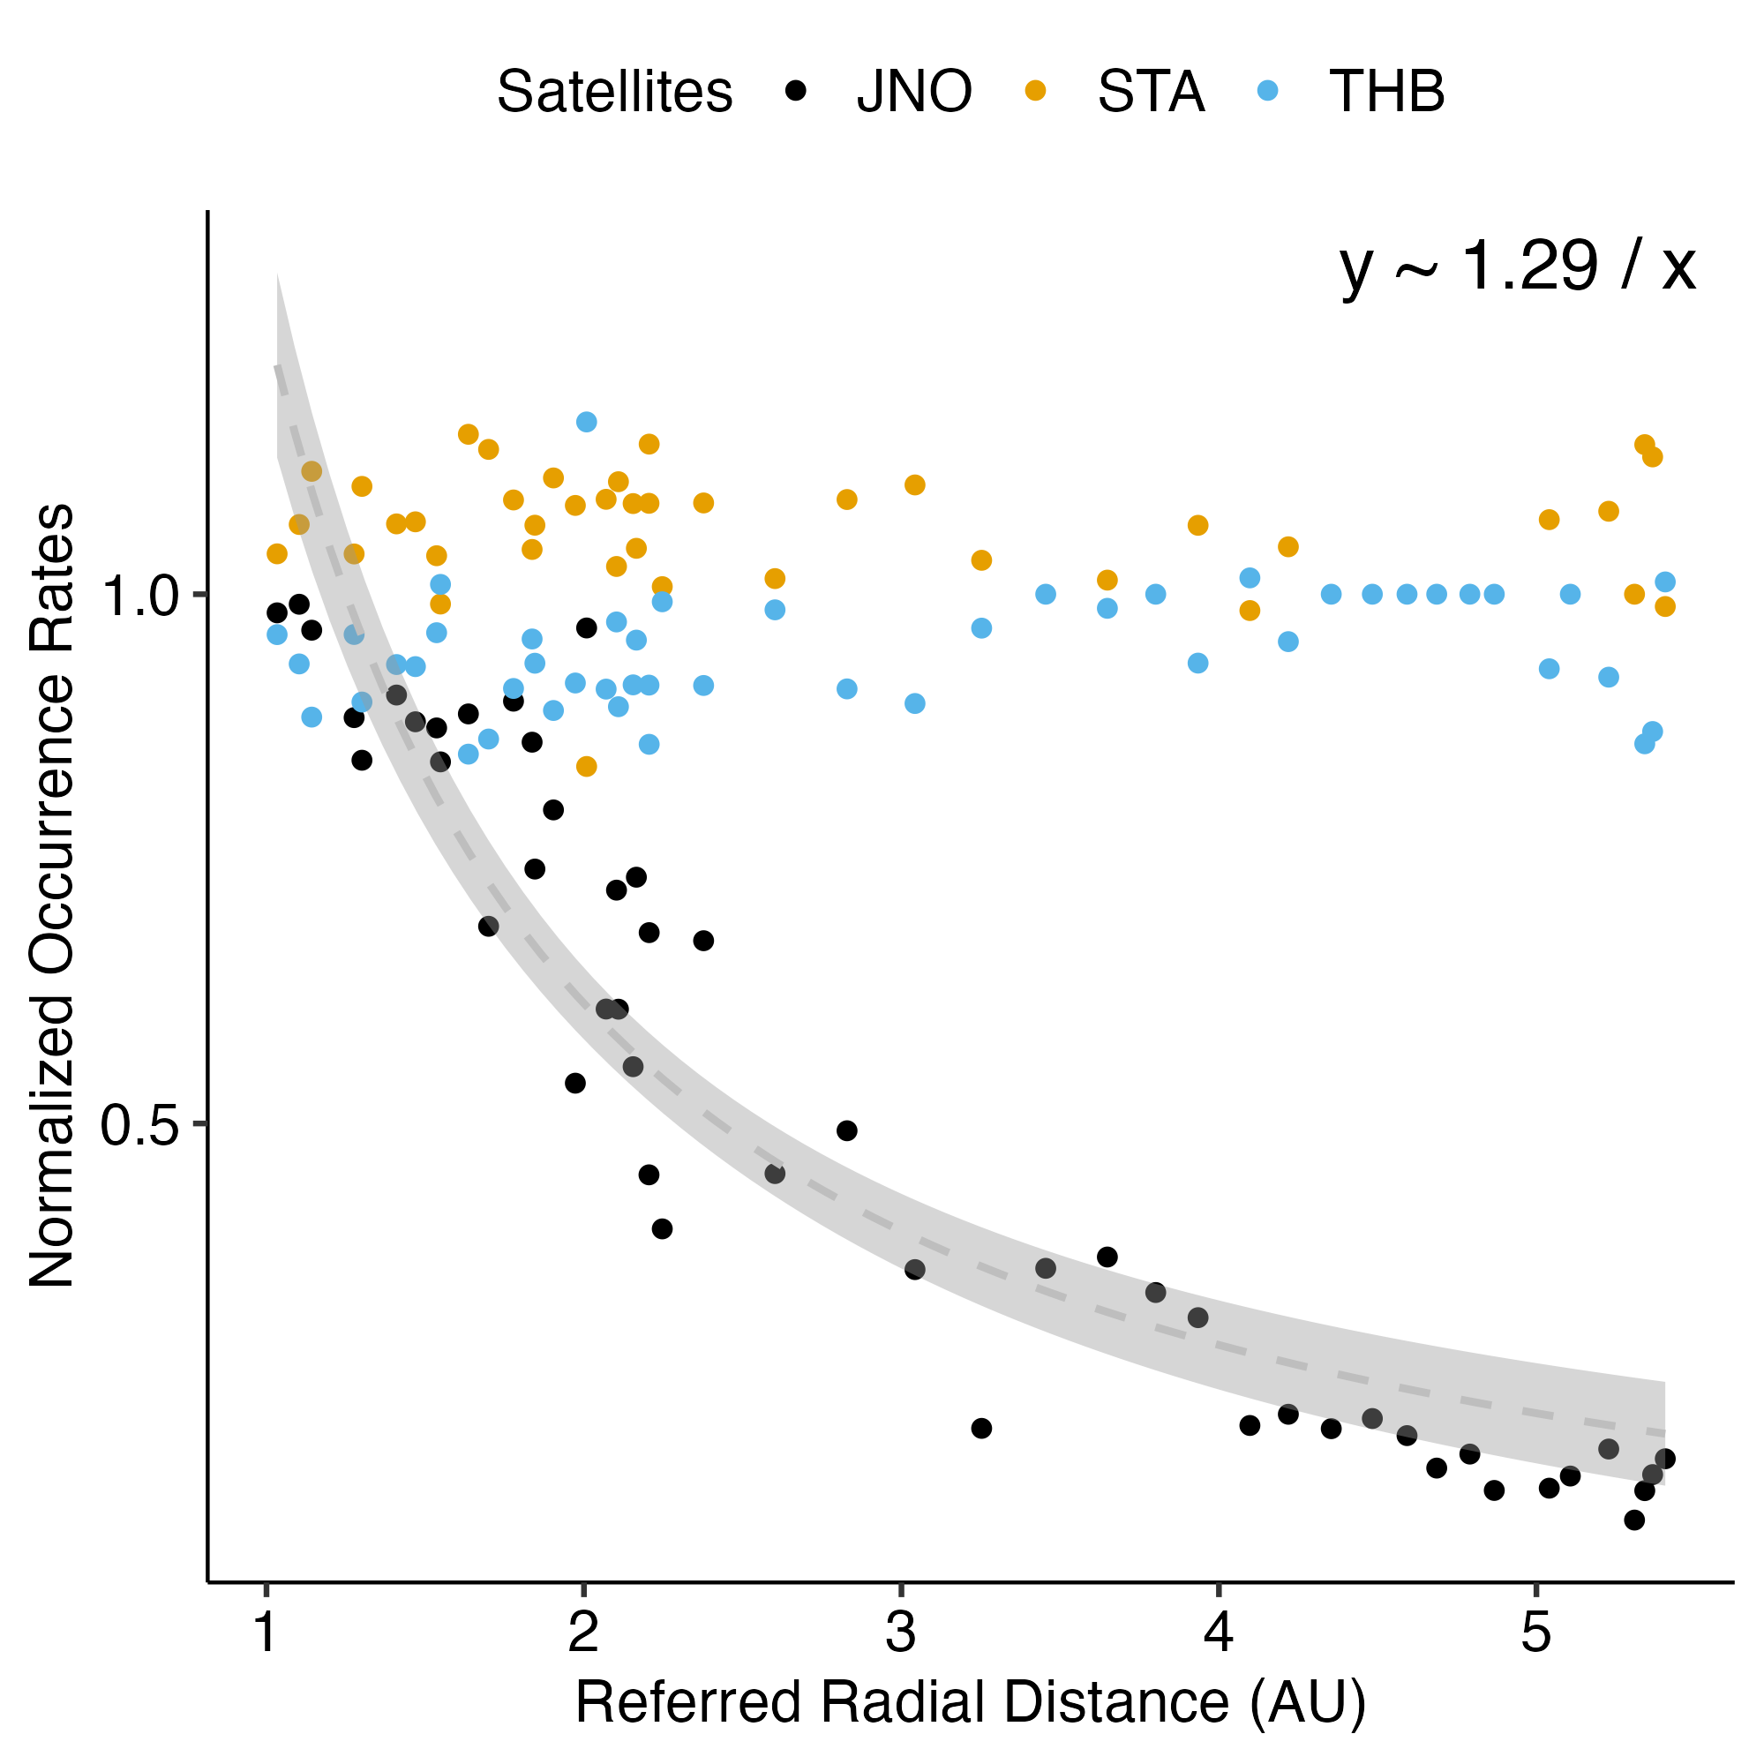
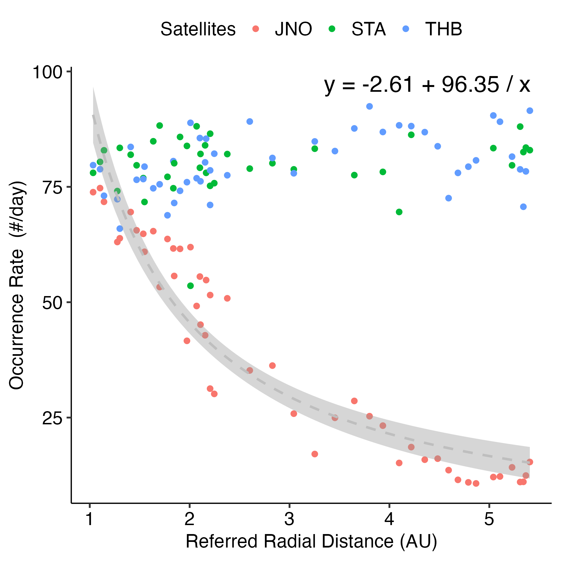
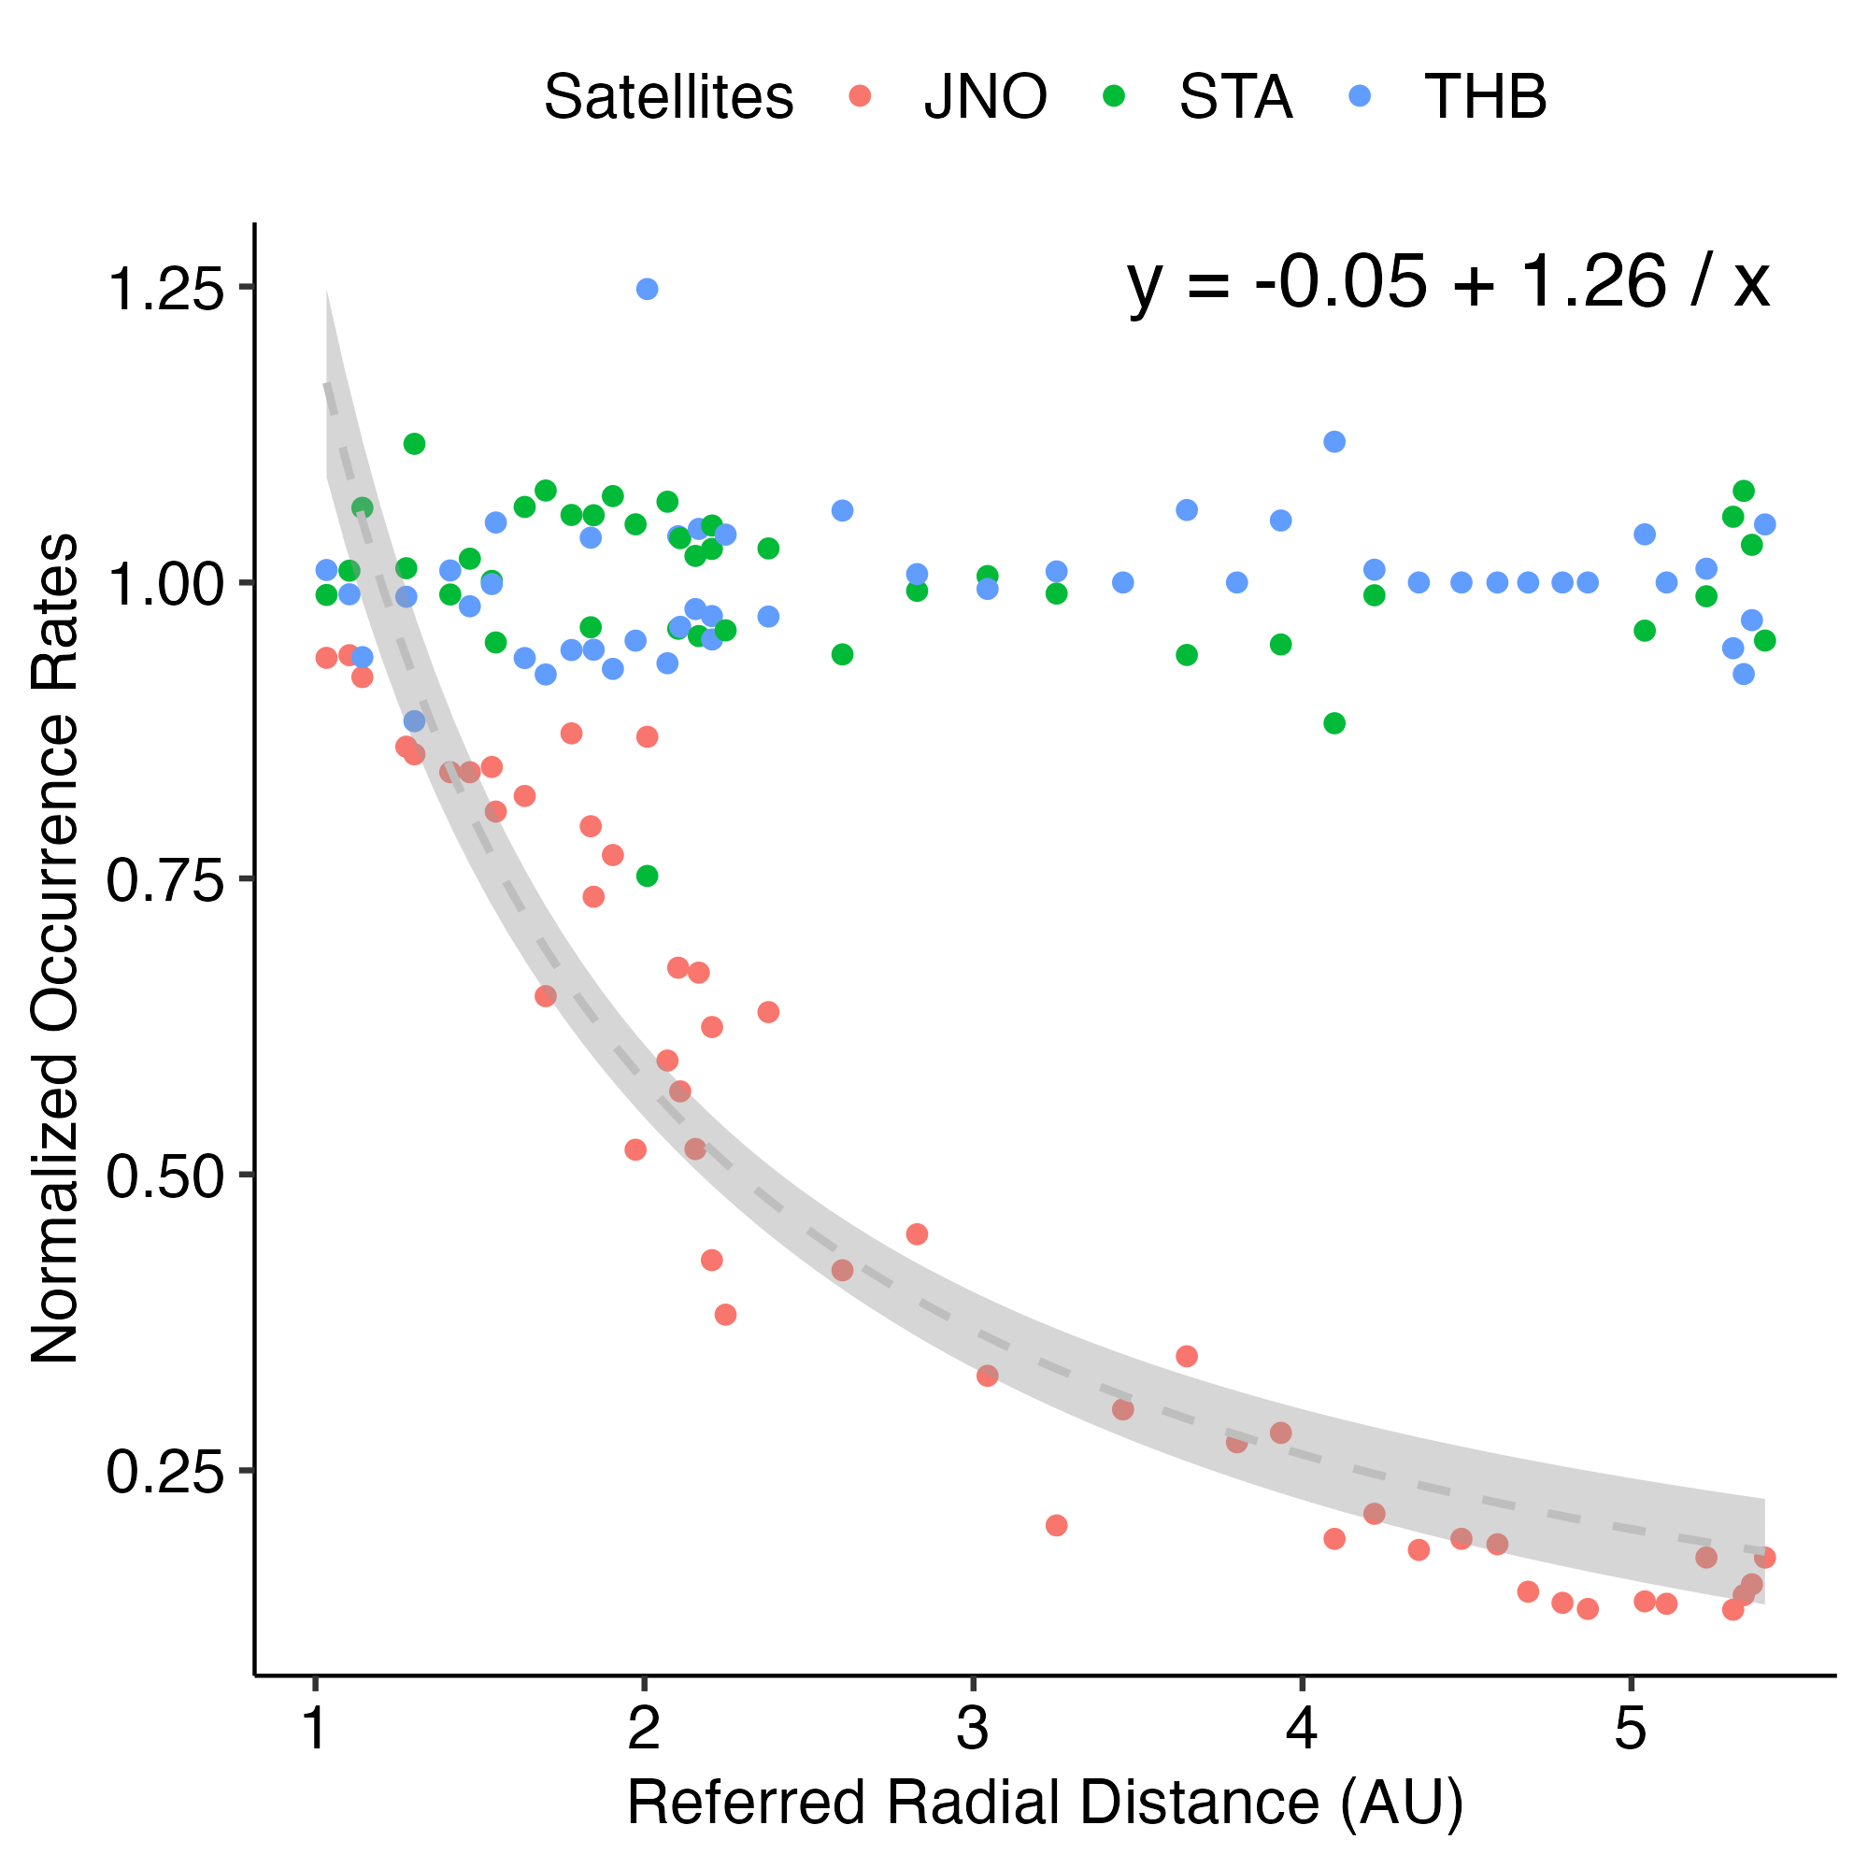
Occurrence rates

Slide 15
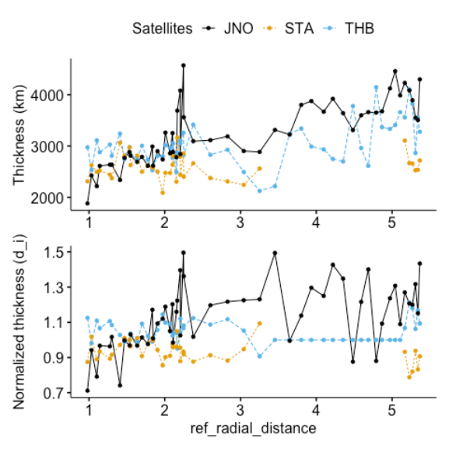
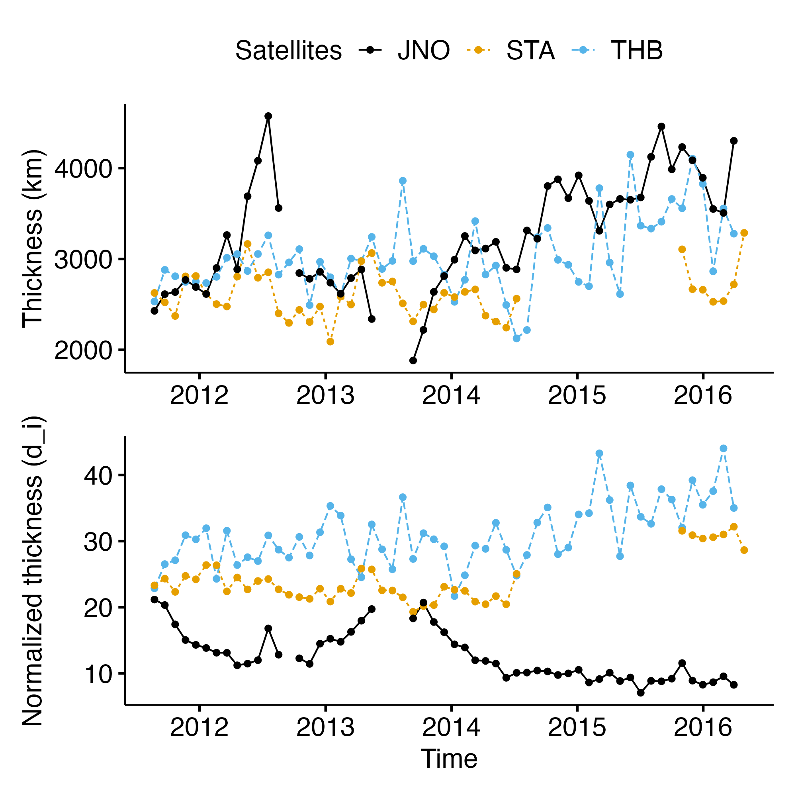
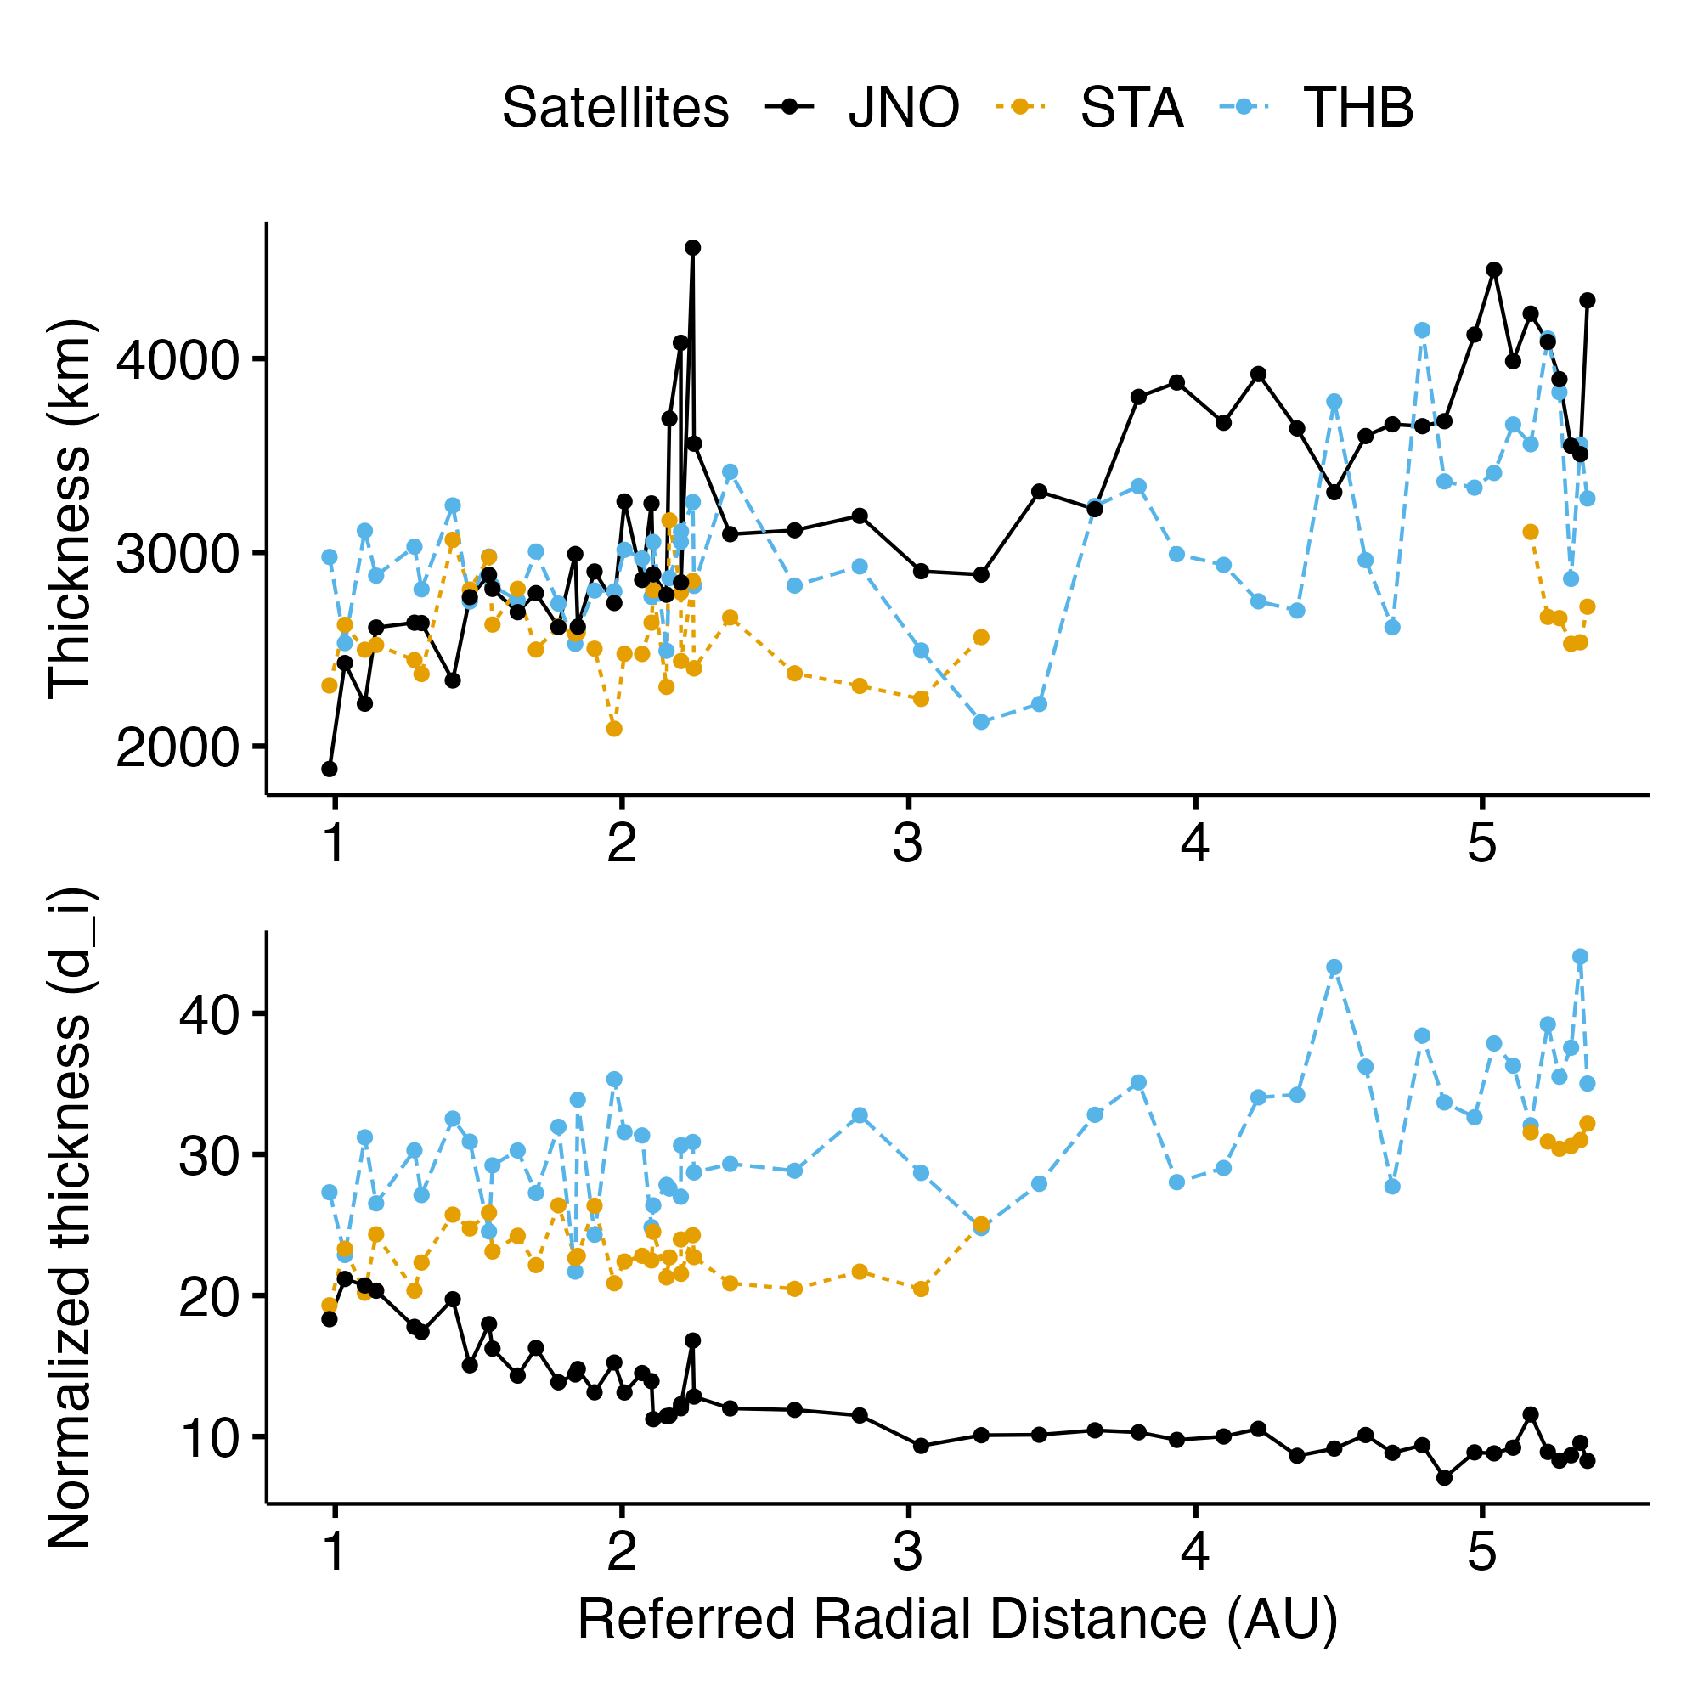
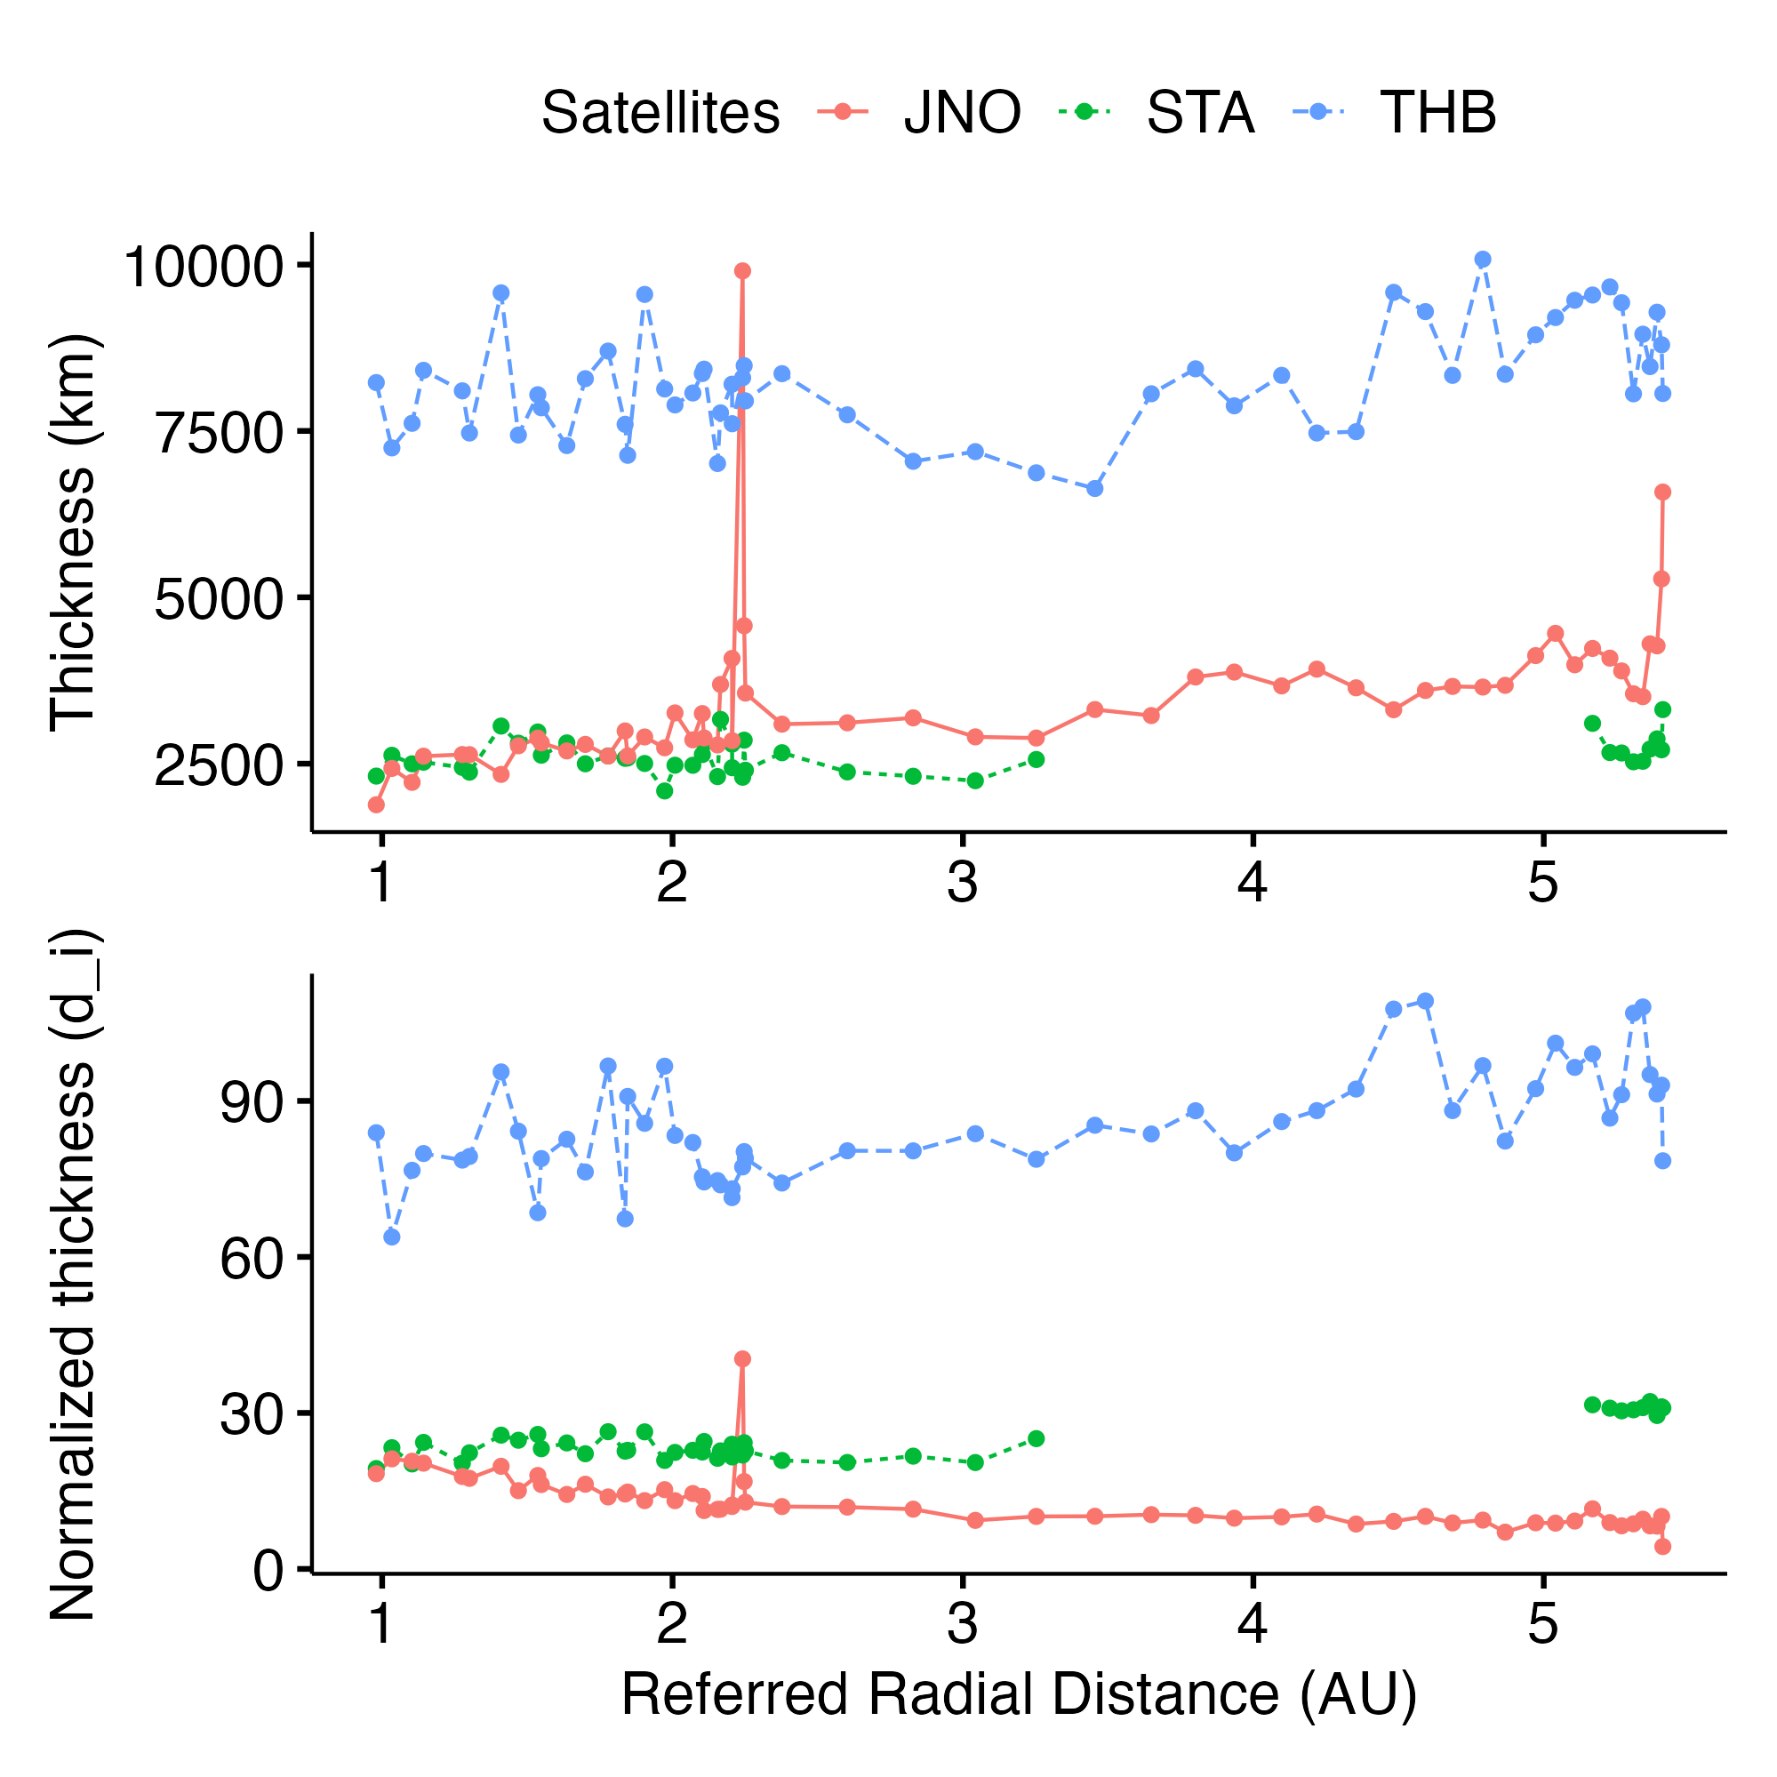
Discontinuities thickness

Slide 16
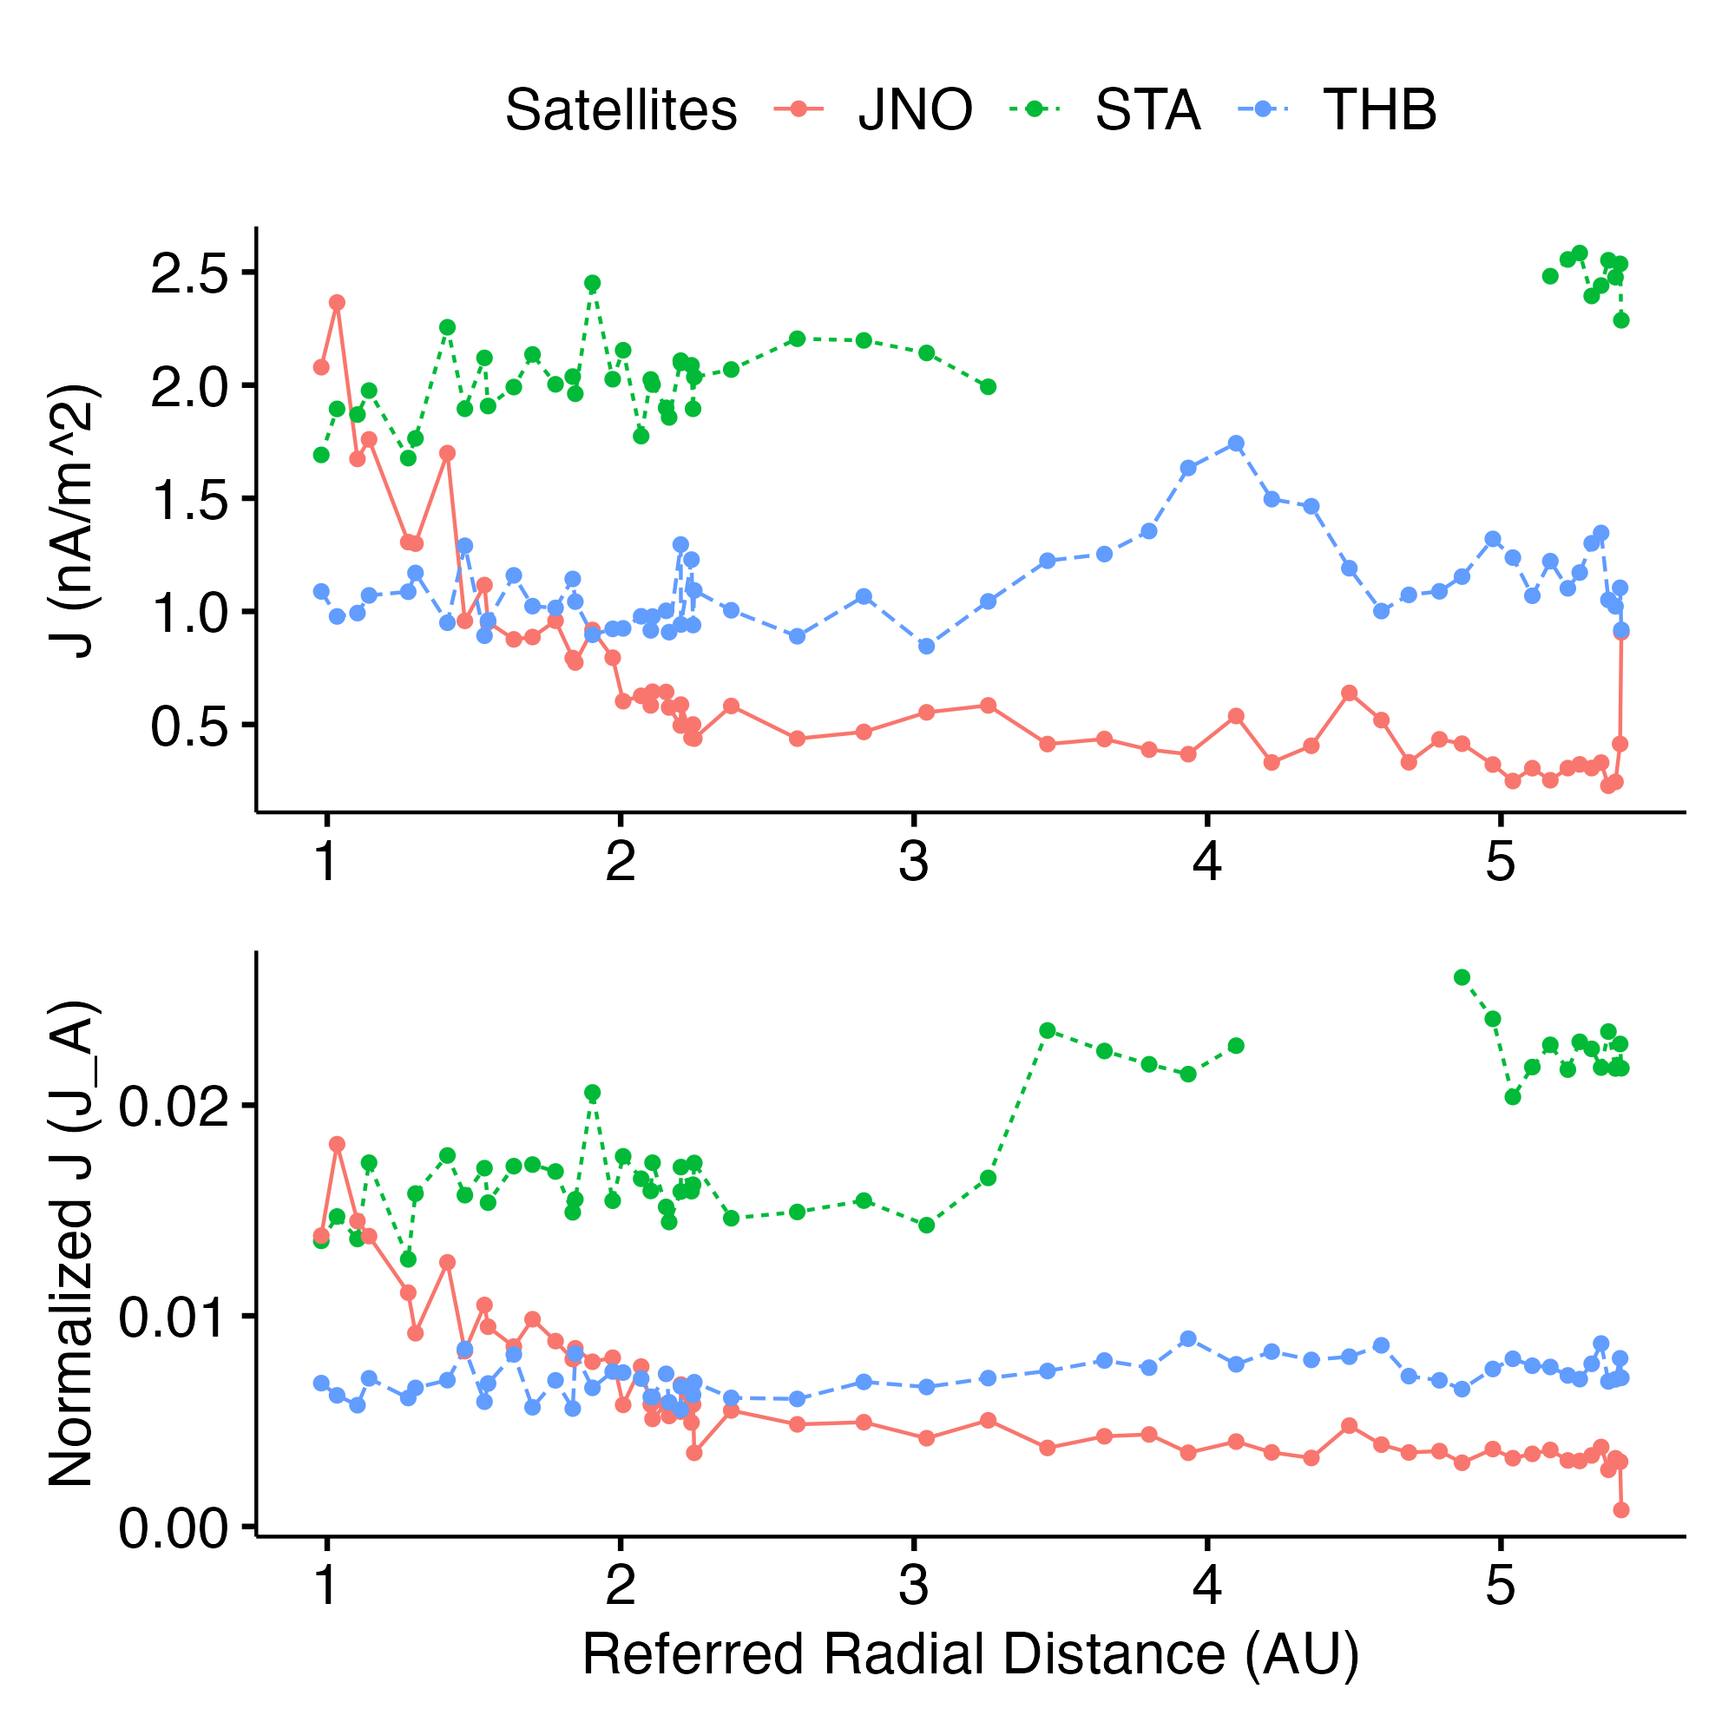
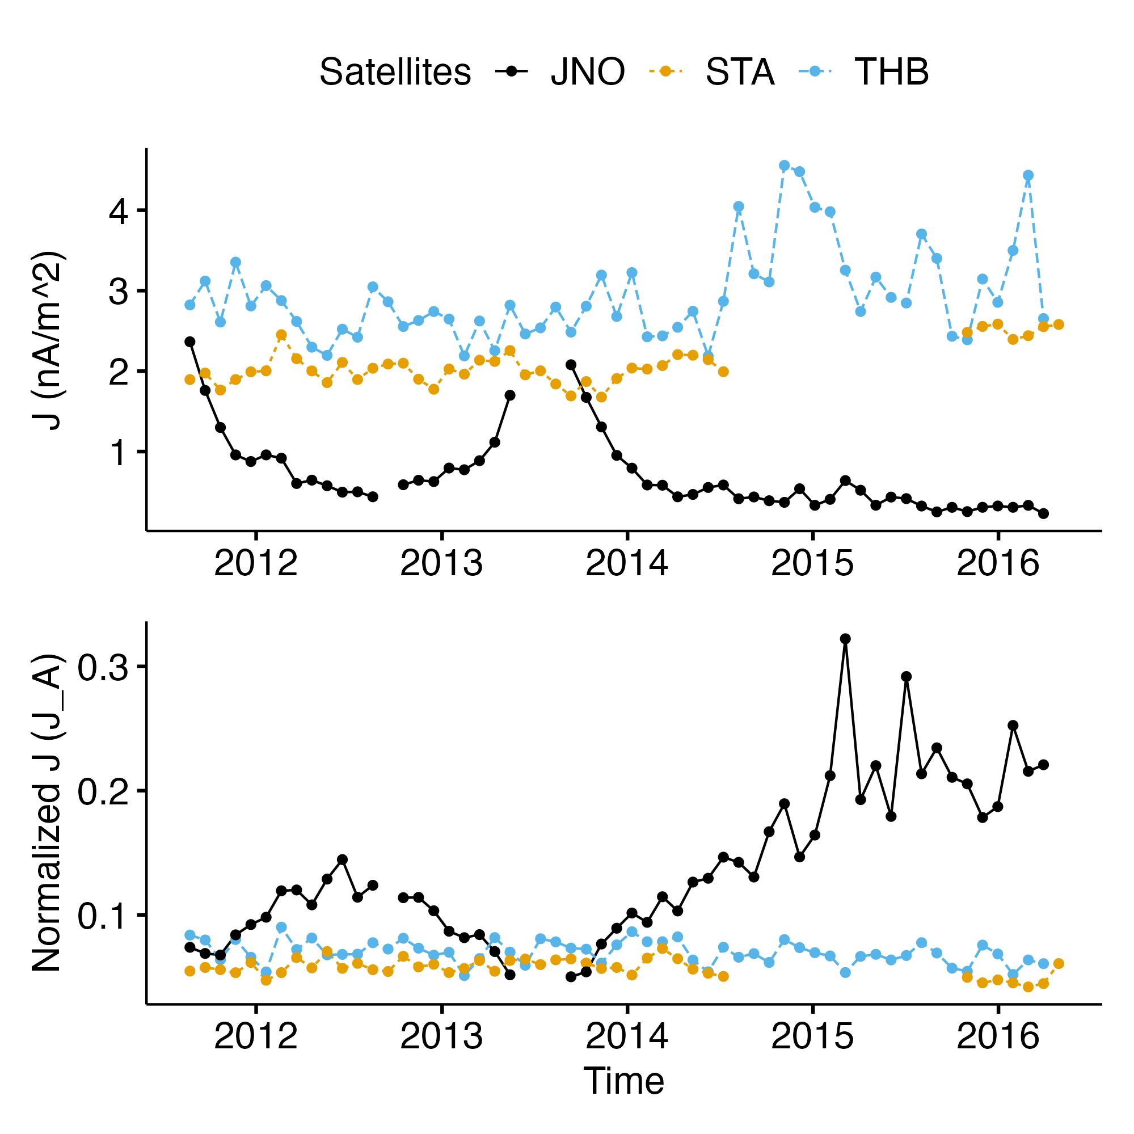
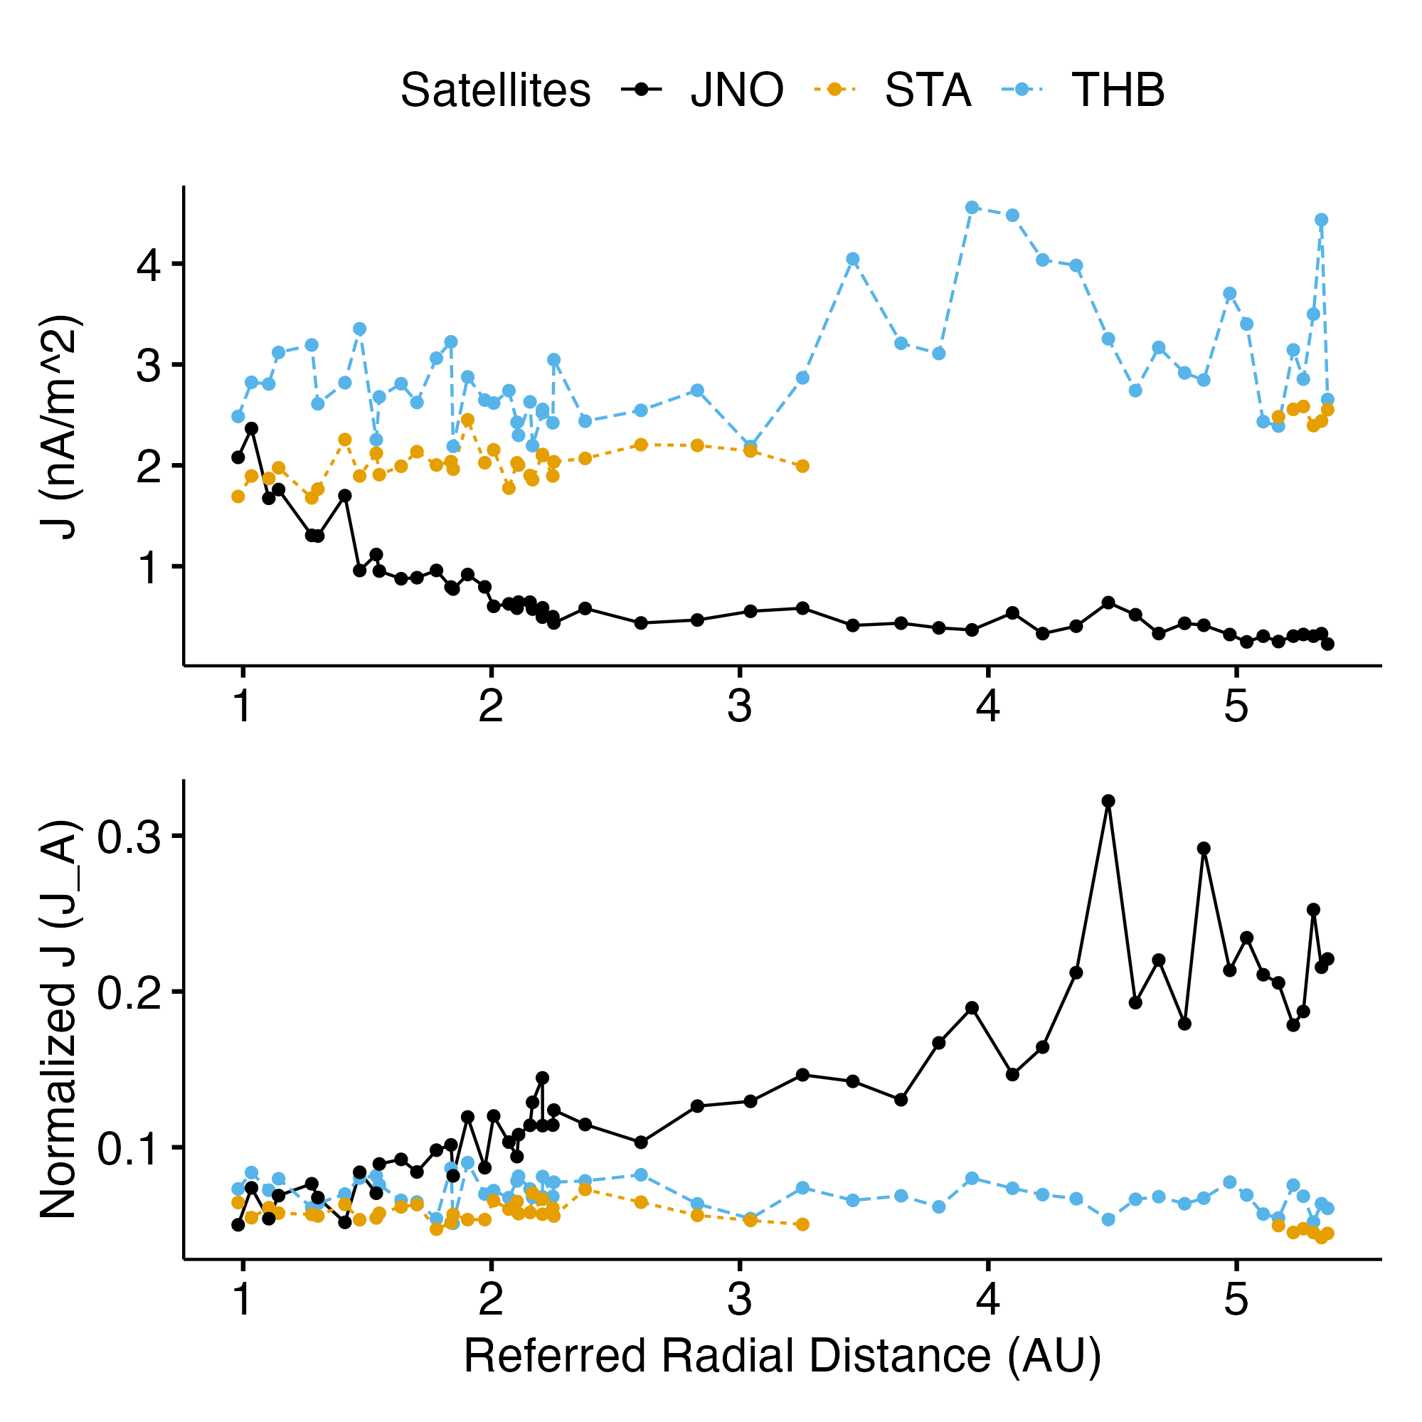
Current intensity

Slide 17


Conclusion
We have collected 5 years of SWD from JUNO, ARTEMIS and STEREO.
We have developed a pipeline to identify SWD (Modular, Performant, Scalable)
github.com/Beforerr/ids_finder

Slide 18
Conclusion
We have collected 5 years of SWD from JUNO, ARTEMIS and STEREO.
We have developed a pipeline to identify SWD
The normalized occurrence rate of IDs drops with the radial distance from the Sun, following 1/r law.
The thickness of IDs increases with the radial distance from the Sun, but after normalization to ion inertial length, the thickness of IDs decreases.
The current intensity of IDs decrease with the radial distance from the Sun, but after normalization to the Alfven current , the current intensity of IDs increases.
To be continued as discontinuities ☺

